Slide 1
360° Leadership Reviews
your name & contact
YOUR LOGO HERE
Notes:
Add images - different titles
Different job roles images
Printed version

Slide 2
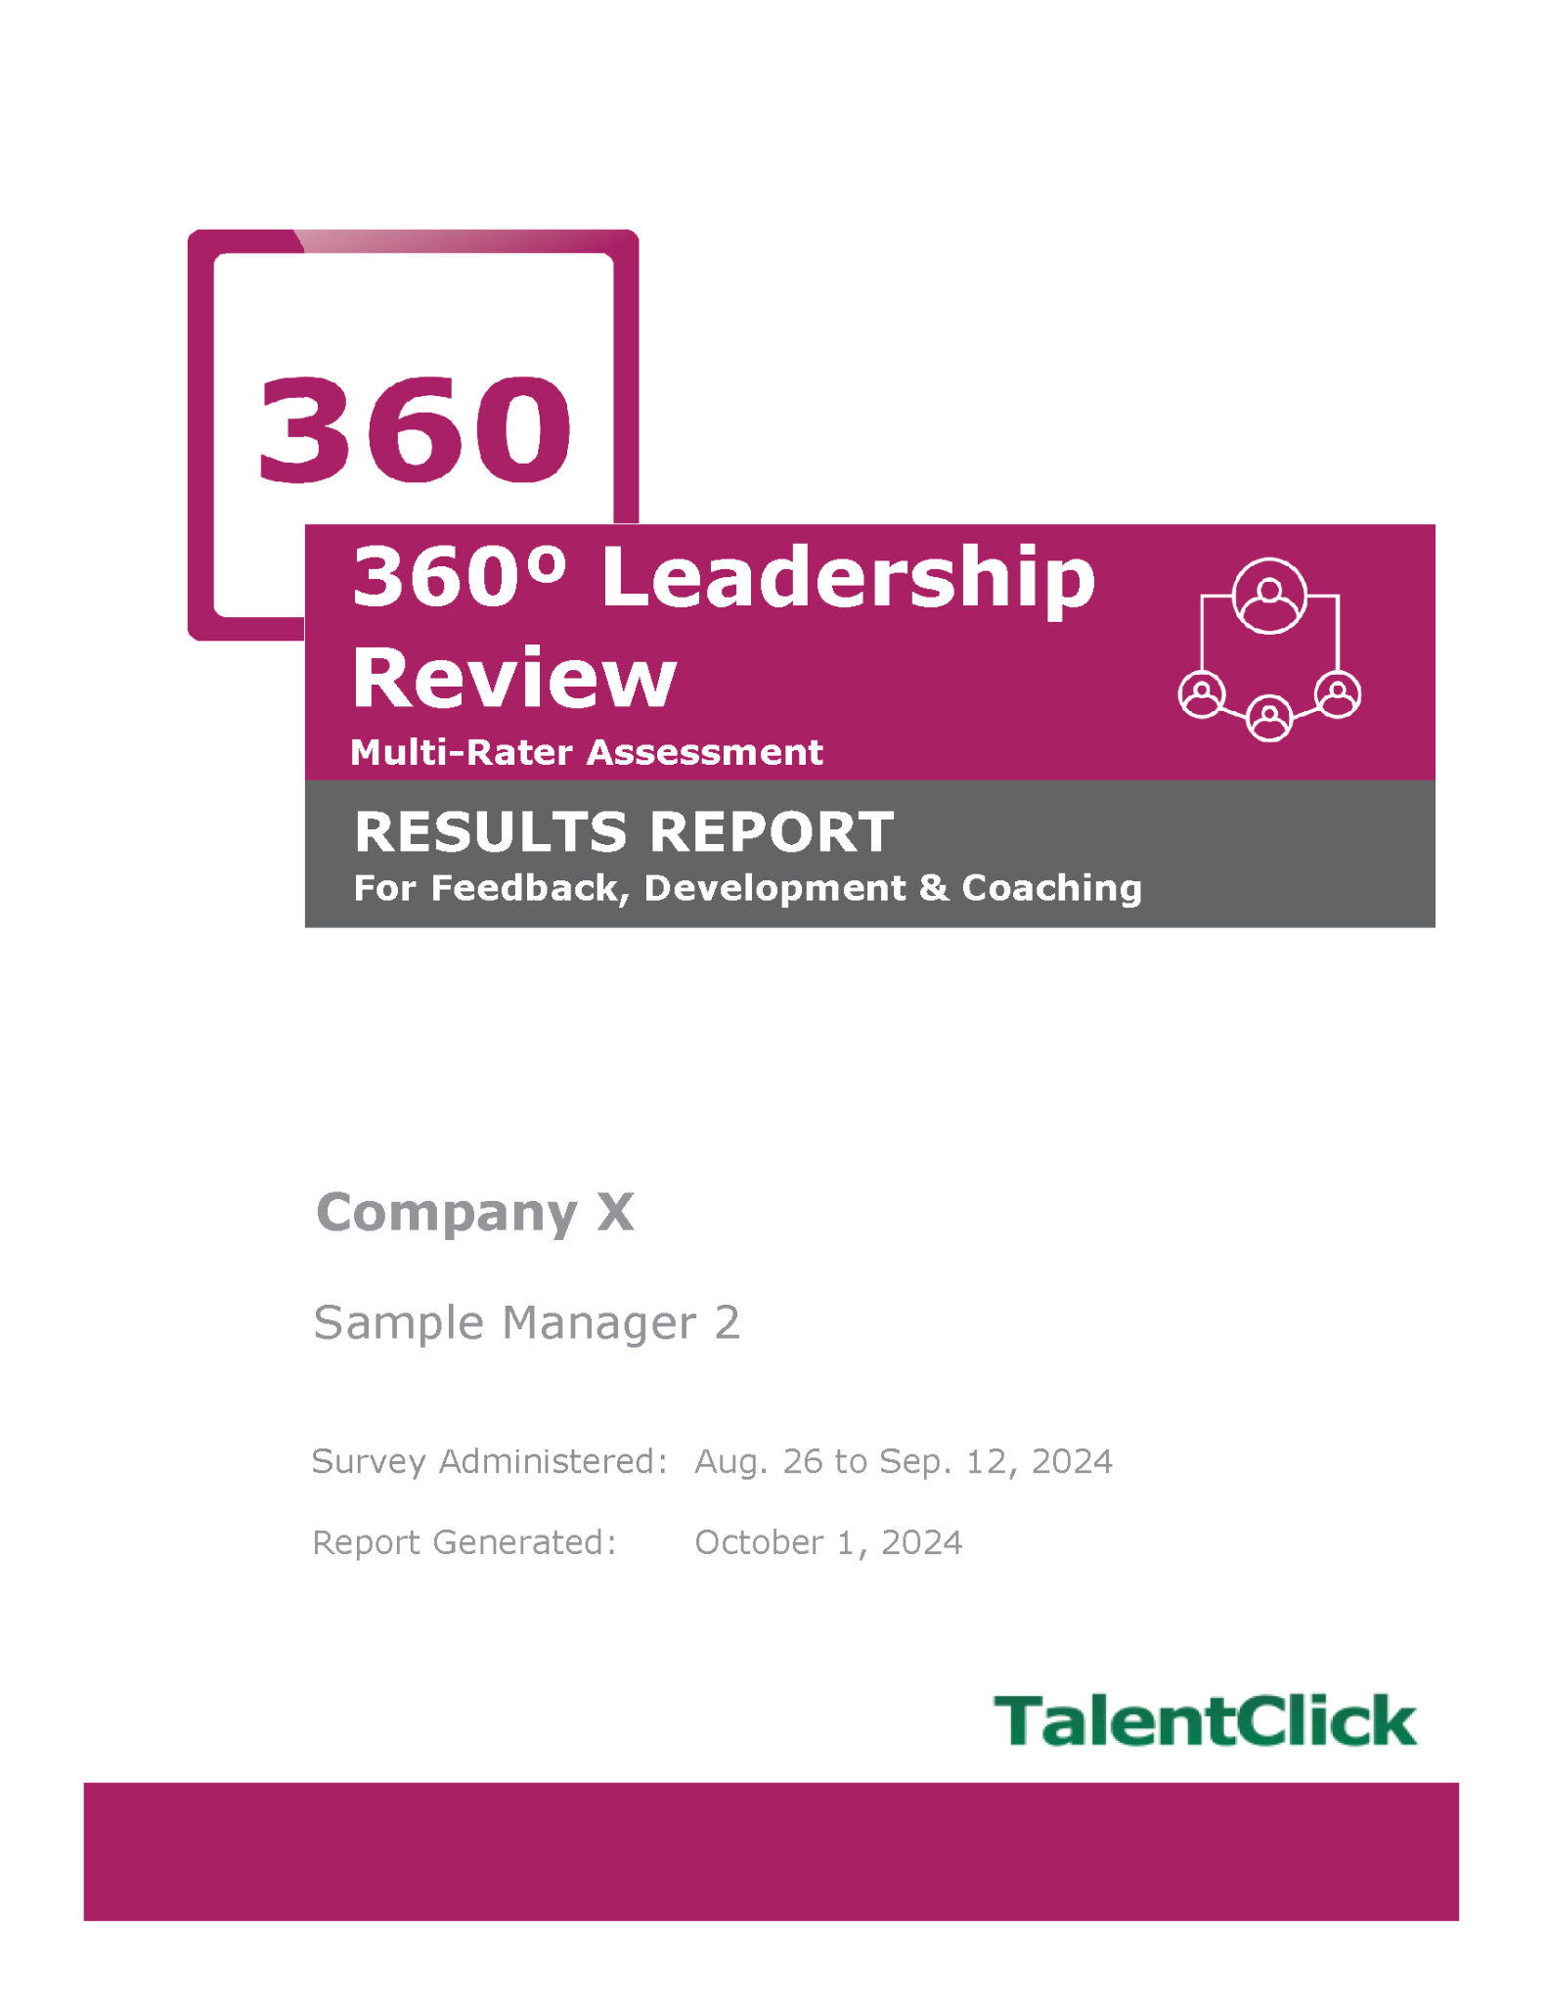
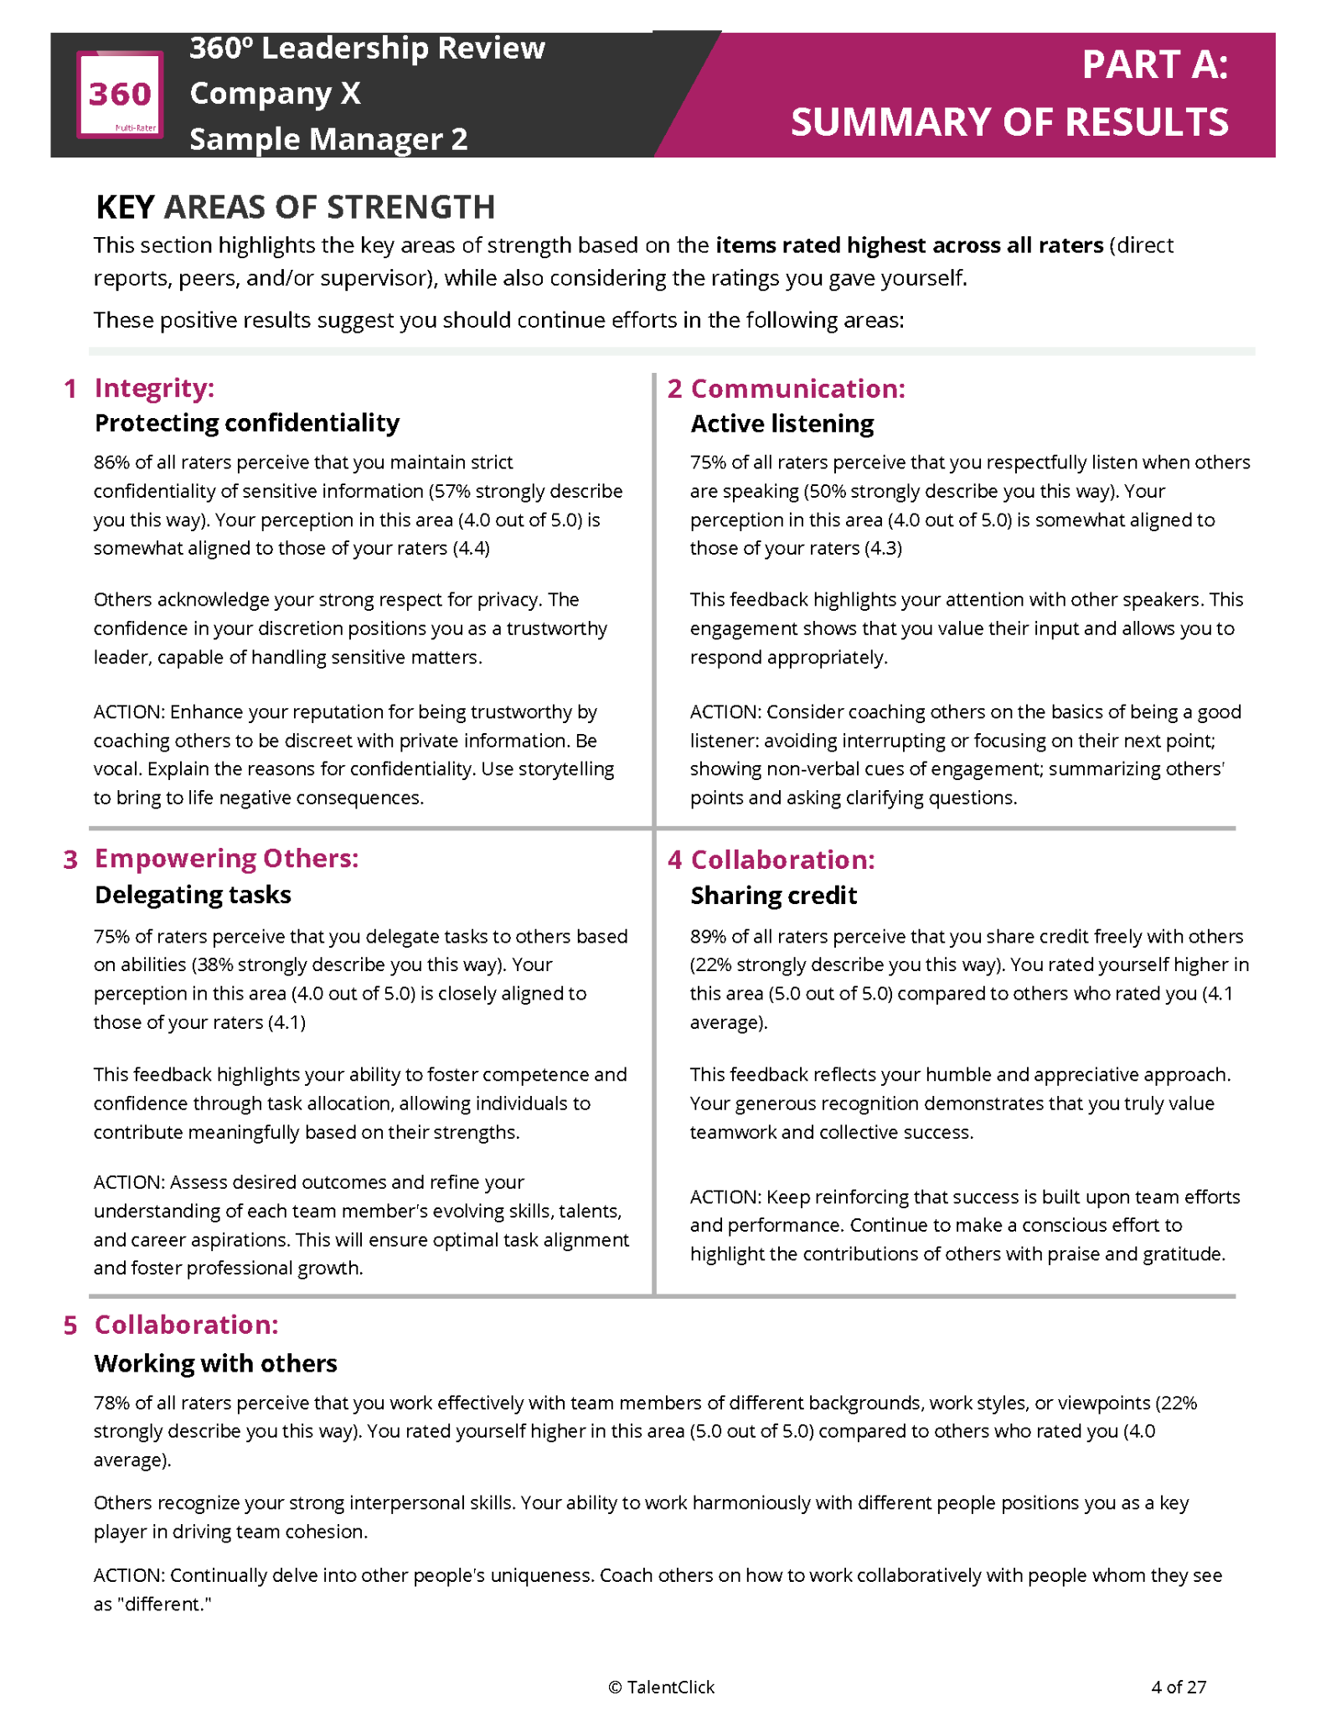
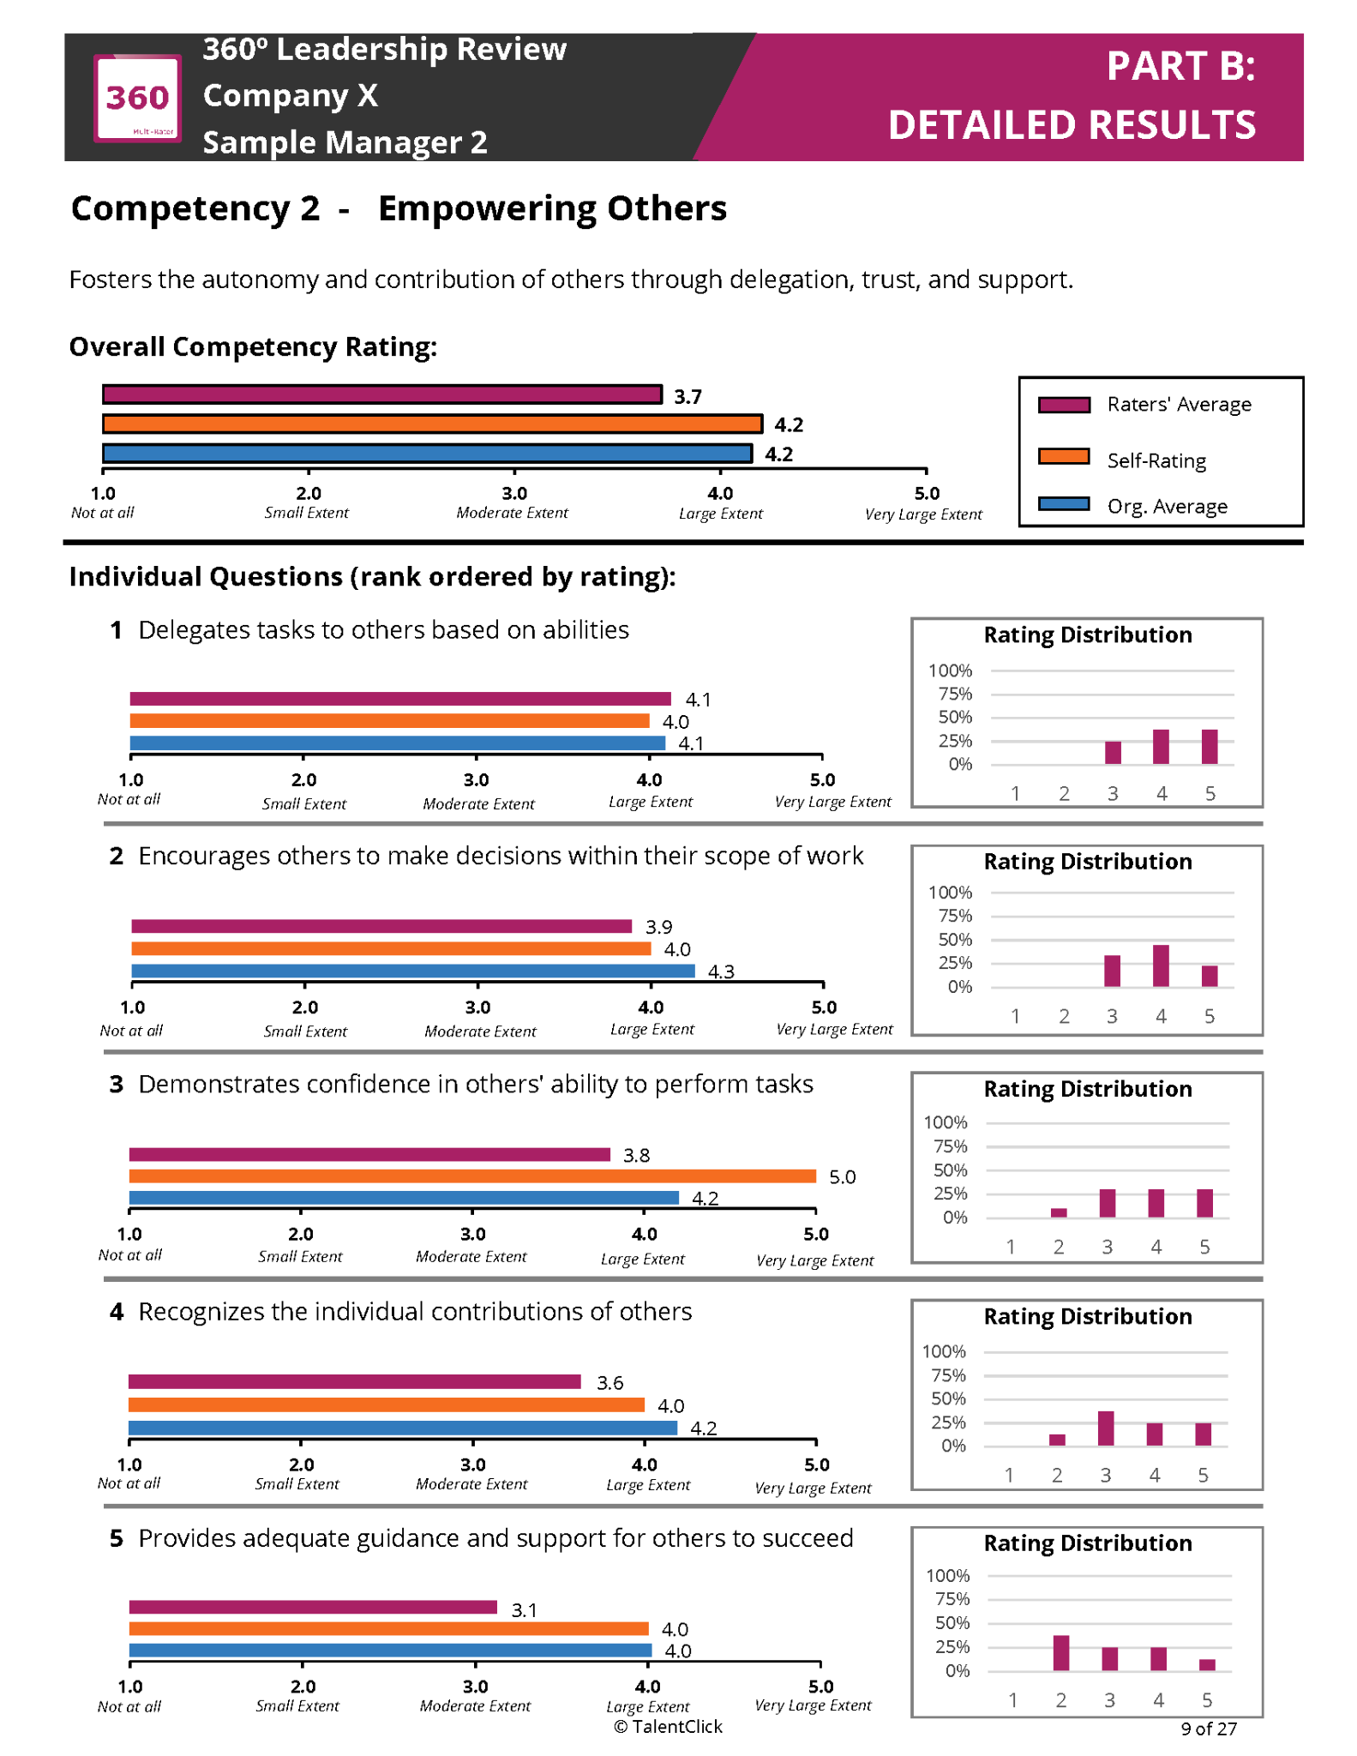
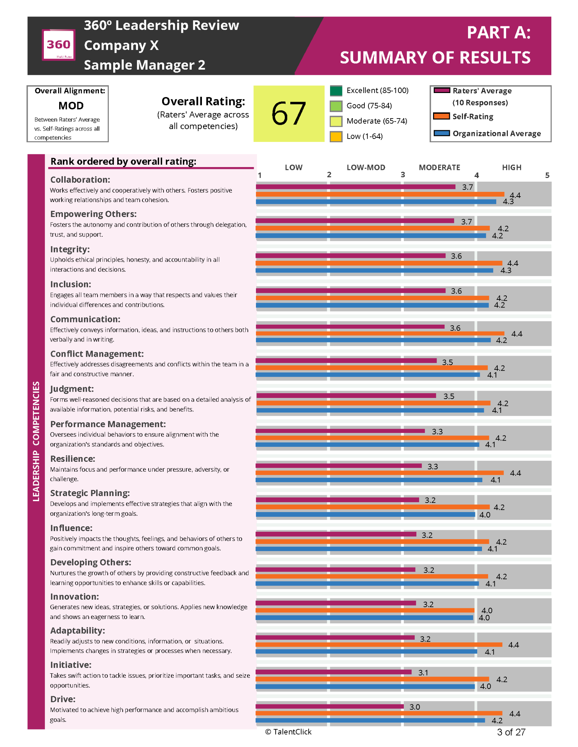
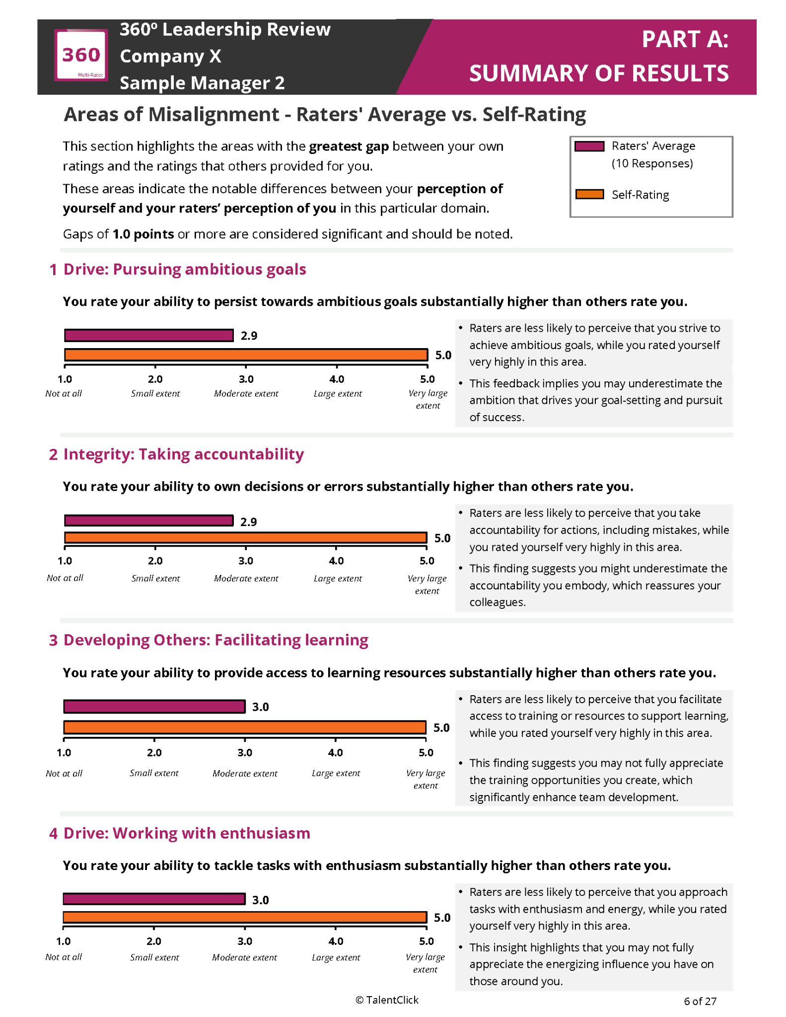
360° Leadership Review Report

Slide 3
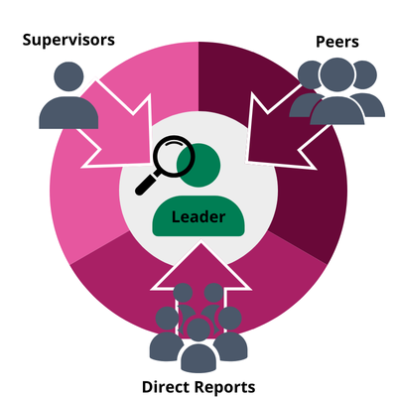
Get started!
Upload list of leader-participants and raters
We send a survey link to raters and the leader-participant
Advise if you require any updates to TalentClick’s standard messaging
Survey Completed in 12-15 minutes
Let us know when you want the survey invite to send and let us do the rest!
We send your organization all leader-participant reports
Within 3-4 weeks, will be automated in 2026
Notes:
SG ADDED - OPTION 2 (SAME CONTENT) - SKIPPED
NOTE: My timelines said report within 10 business days after survey completion; however, the updated agreement says “within 21 business days.”

Slide 4
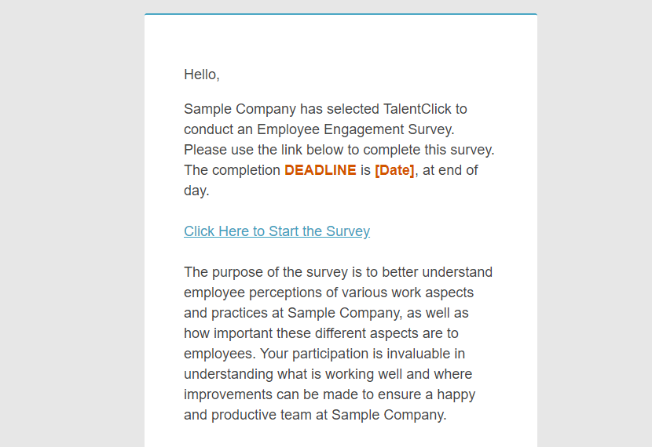
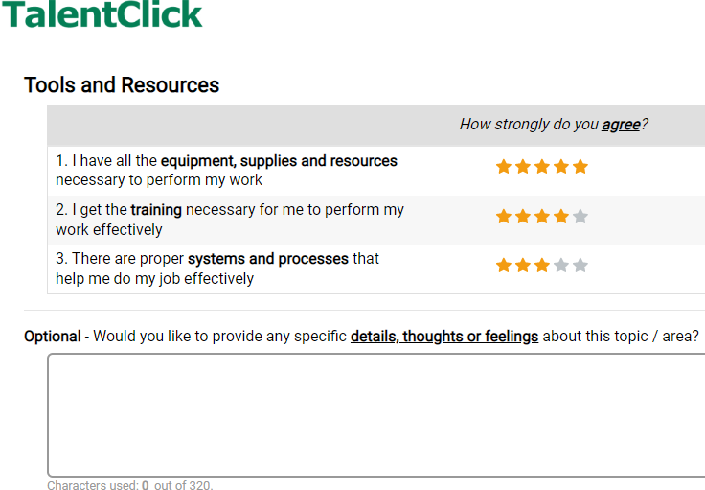
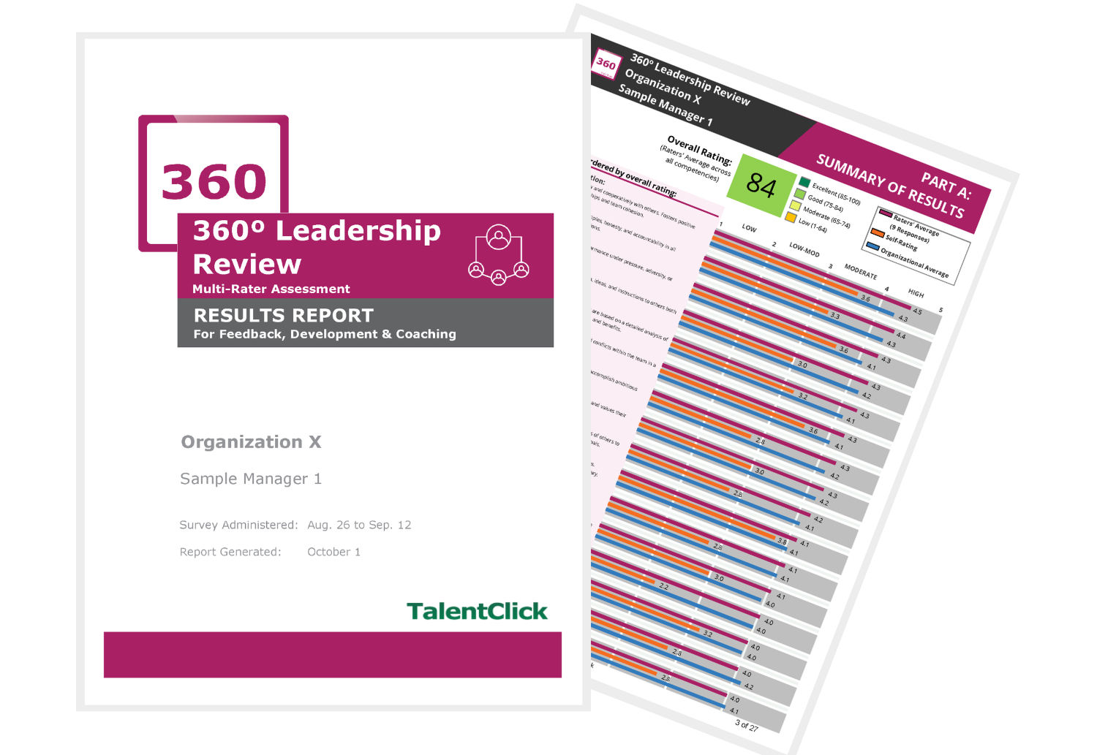
How Does it Work?
1.
2.
3.
Invite Participants
Typically 4-10 raters per leader-participant
Raters include:
Leader-participant’s supervisor
Their direct reports
Their peers
Participants Complete Survey
Online (computer, tablet or phone)
12-15 minutes
Available in 5 languages
Confidential
Get Results!
Results within 3-4 weeks
Comprehensive summary & detailed results report for each leader-participant

Slide 5


What you receive:
Summary of Results
Overview of Leadership Competencies
Leadership Outcomes
Areas of Strength and Development
Areas of Misalignment (Raters’ Avg. vs. Self-Rating)
Detailed Results on Leadership Outcomes and Competencies
Additional Comments for areas of strength and development
General Feedback with Open-Ended Responses

Slide 6
Easy to Interpret Reports

Slide 7



Discover Priorities AND Action Items
Participant Ratings
Highlights
Action Tip

Slide 8

Benefits of Implementing
360° Leadership Review
✓ Broader Perspective
✓ Leadership Confidence
✓ Bias Reduction
✓ Leadership Improvement
✓ Team Improvement
✓ Employee Engagement & Retention
✓ Succession Planning
Notes:
Follow the lead of world-class organizations and make smarter people decisions. A professional 360° review process can help you achieve these results:
Broader Perspective: Bridge the gap between what leaders think of themselves and how others view them within the organization
Bias Reduction: Reduce possible bias from a single reviewer by receiving feedback from numerous people who work with the leader
Leadership Confidence: Increase a person’s self-awareness of their own strengths and reinforce positive behaviors
Leadership Improvement: Increase a person’s self-awareness of their areas for improvement and create a development plan
Team Improvement: Improve leadership to help improve team effectiveness and increase productivity
Employee Engagement & Retention: Gauge employee dissatisfaction and coach leaders on specific areas most likely to increase engagement
Succession Planning: Compare various leaders’ results as part of your process for succession planning and promotions

Slide 9

Pricing
Your Quote: $XXX
Minimum order of 4
Volume discounts may apply

Slide 10

Questions?
TalentClick
info@talentclick.com
1.877.723.3778
YOUR NAME HERE
Your contact details here

