Slide 1
Measure Workforce Sentiment and Drive Organizational Improvement with
Employee Engagement Surveys
YOUR CONTACT DETAILS HERE
YOUR LOGO HERE

Slide 2


Agenda
Who is TalentClick?
What Do We Help With?
Details of the Employee Engagement Survey

Slide 3
Who is TalentClick?

Slide 4
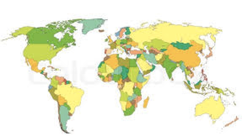
Who is TalentClick?
A Global leader in Psychometrics, used by thousands of business leaders in more than 100 countries worldwide, in 25 languages.

Slide 5








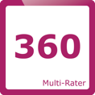


Broad Suite of Assessment Solutions
Attitude-Values-Personality
A combination of our three most
popular assessments
Leadership Profile
Identify leadership capabilities, business
reasoning and conflict management
Workstyle & Performance Profile
Assesses workstyle, strengths and areas for improvement
Cognitive Quotient
Test spatial reasoning, language, and
numerical problem-solving ability
Work Values & Attitude
Predict conformity, responsibility, coachability, positivity and more
English Proficiency
Measure English language competencies,
writing, vocabulary and typing speed
Safety Quotient
To identify people with higher risk tolerance. Decrease human error and incidents
Multi-Rater Solutions
Employee
Engagement
Survey
360 Degree Leadership Review
Driver Safety Quotient
Understand a driver’s likelihood of crashes, traffic violations and more
Safety Culture Survey

Slide 6
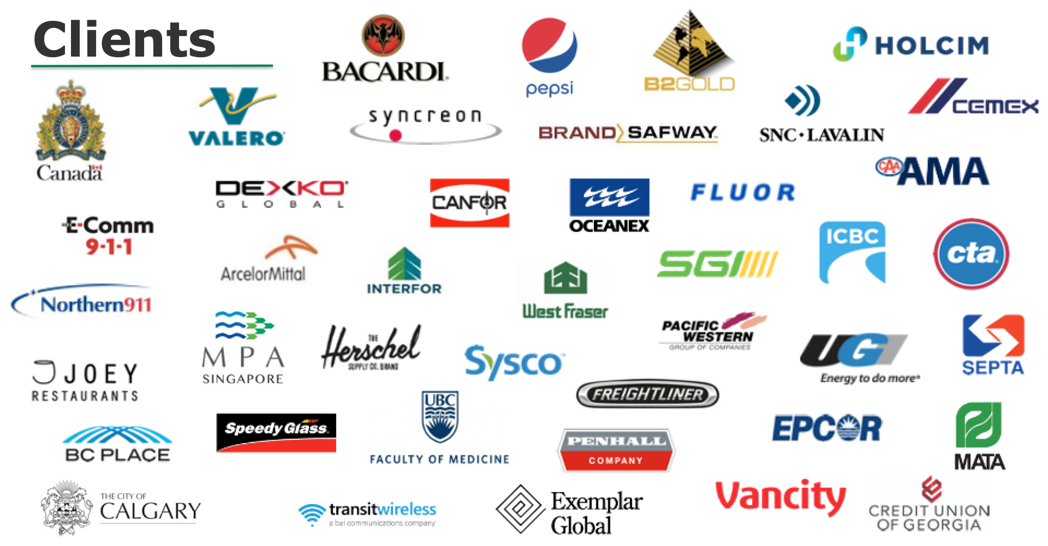































TalentClick Clients

Slide 7


Results of Better
Engagement
✓ Happier Employees.
✓ Improved morale. Better culture.
✓ Decreased employee turnover.
✓ Reduced costs of hiring, training.
✓ More time for other duties.
✓ Increased productivity/profitability.
✓ Enhanced employer brand.

Slide 8
What Do We Help With?

Slide 9


Slide 10

The Problem
Employee turnover costs equal avg. of
1 year's salary and benefits Source: PWC/Saratoga
Employee Disengagement costs employers billions of dollars every year in low morale, high employee turnover, lost productivity, lost customer business.

Slide 11

The Goal
When employees are happier at work…
85% say they take more initiative
73% say they are better collaborators
48% care more about their work
Source: “Happiness at Work” poll by Partners in Leadership, 2017

Slide 12

The Challenge
But how can we be certain what will make employees happy?
Leaders think they know what employees want. Often they’re wrong.
Leaders need objective, quantifiable data from a 3rd party to help discover what employees really think.

Slide 13
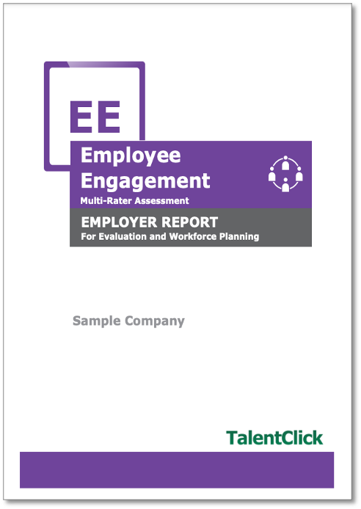
The Solution
Use the Employee Engagement Survey by TalentClick
Measure workforce sentiment using a 3rd party, objective tool.

Slide 14
Details of the
Employee Engagement Survey

Slide 15
What Is It?
What is the Employee Engagement Survey?
The Employee Engagement Survey is a diagnostic scan of workforce of workforce sentiment that provides a gap analysis between what leaders think is happening in the organization and what is really happening. You will gain:
Employee perceptions about the key aspects of the job that predict engagement, such as workload, flexibility, and supervisory support
Snapshot of overall employee intentions toward the organization, such as commitment and intention to remain in the role
Actionable insights into areas of strength and development to enhance engagement, productivity and performance
Quantitative business intelligence to inform targeted organizational initiatives
Qualitative feedback from employees in the form of open-text responses

Slide 16
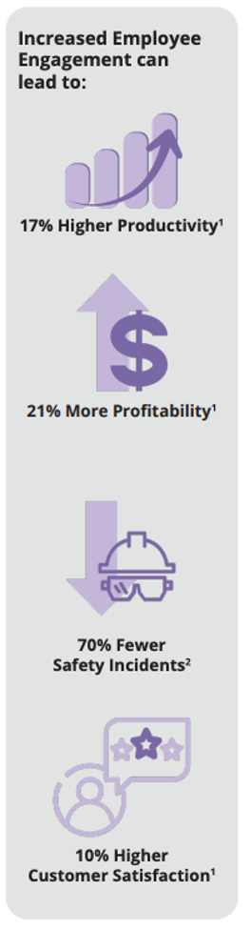
Why Use It?
Why Use an Employee Engagement Survey?
Make better people decisions! Get year-over-year comparative data and business intelligence to aid your decision support. We’ll help you drive organizational gains in these areas:
Increased employee satisfaction and improved morale
Decreased employee turnover and increased retention
Reduced costs for recruitment, hiring, training
Increased productivity
Enhanced culture and employer brand

Slide 17
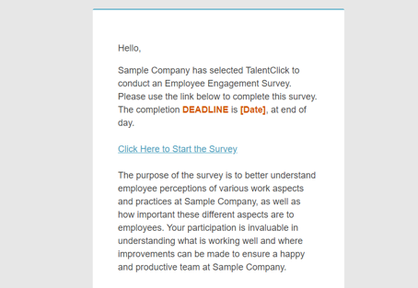
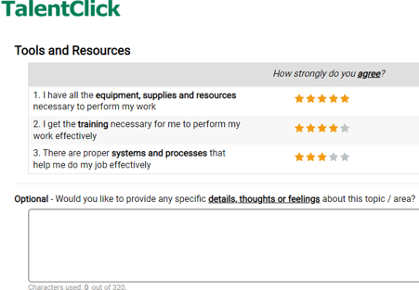
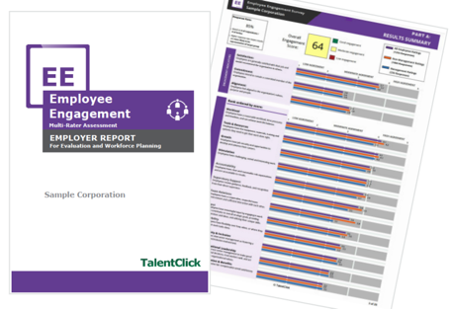
How Does it Work?
1.
2.
3.
Invite Participants
TalentClick sets up automated email campaign to send survey invites (& reminders) to all chosen participants
Participants Complete Survey
Online (computer, tablet or phone)
12-15 minutes
Available in 6 languages
Confidential
Get Results!
Results within 21 business days
Comprehensive master report & appendix with open-ended feedback
Notes:
SG ADDED (TO REPLACE SKIPPED SLIDE BELOW)
NOTE - Could add 4th step, before results (Track completion & send reminders)

Slide 18
Tips for Surveying
“Over communicate” to employees what the project is about.
Only select employees who have been with your org. at least 90 days.
Keep in mind that a typical response/participation rate may be only 40-60% of invited participants.
Consider offering an incentive to increase the participation rate.
A prize draw is fine, but a reward-per-person is better.

Slide 19
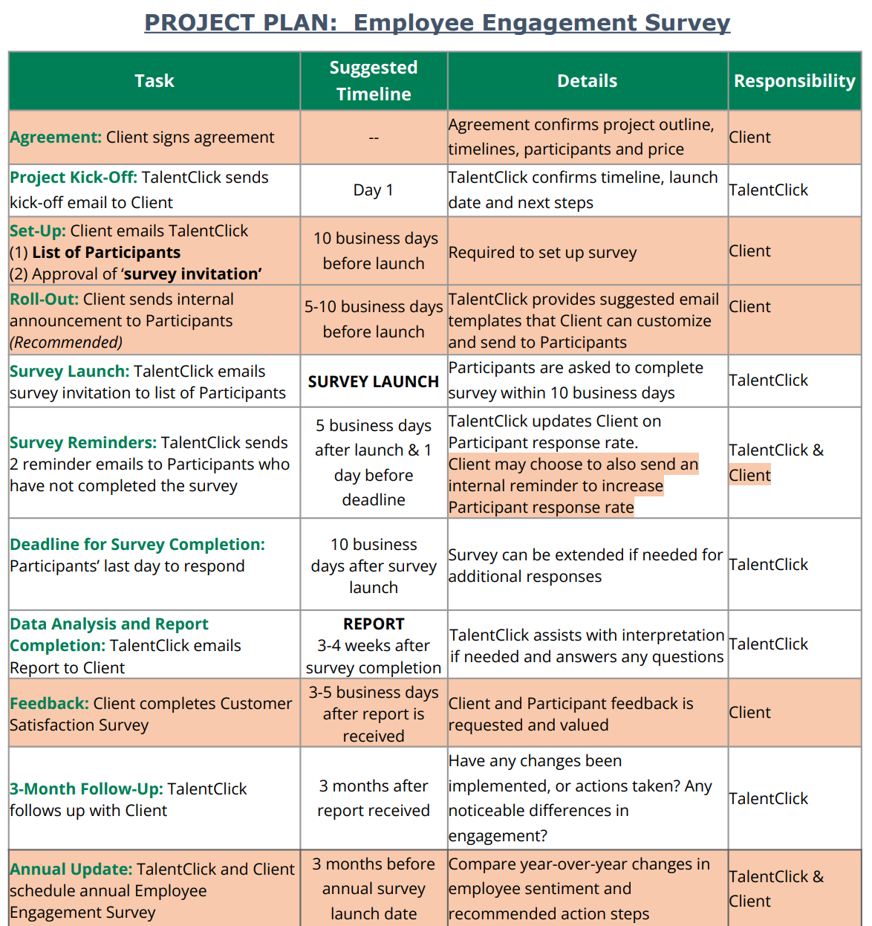
Get started!
1. Send Us List of Participants
2. Review ‘Survey Invite’
3. Confirm Timelines
List of email addresses for all employees who you wish to participate
Advise if you require any updates to TalentClick’s standard messaging
Let us know when you want the survey invite to send and let us do the rest!
Notes:
SG ADDED - OPTION 2 (SAME CONTENT) - SKIPPED
NOTE: My timelines said report within 10 business days after survey completion; however, the updated agreement says “within 21 business days.”

Slide 20

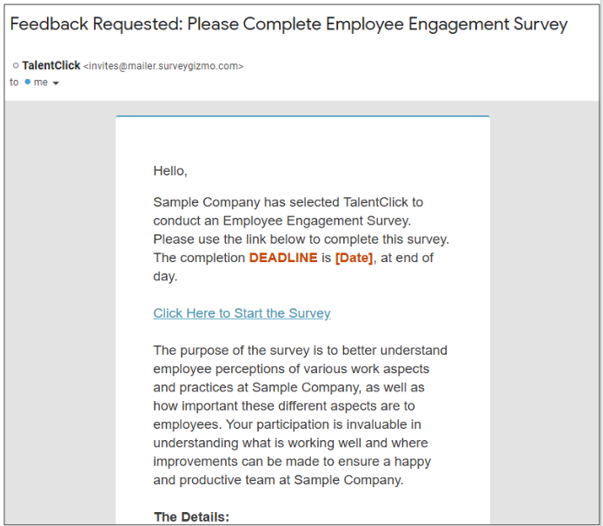
Survey Invitation
Statement of Confidentiality: “Your ratings will be combined with the ratings from all other employees. Your individual responses will NOT be reported or shared with anyone within your organization.”
Notes:
SG ADDED (IF NEEDED)

Slide 21
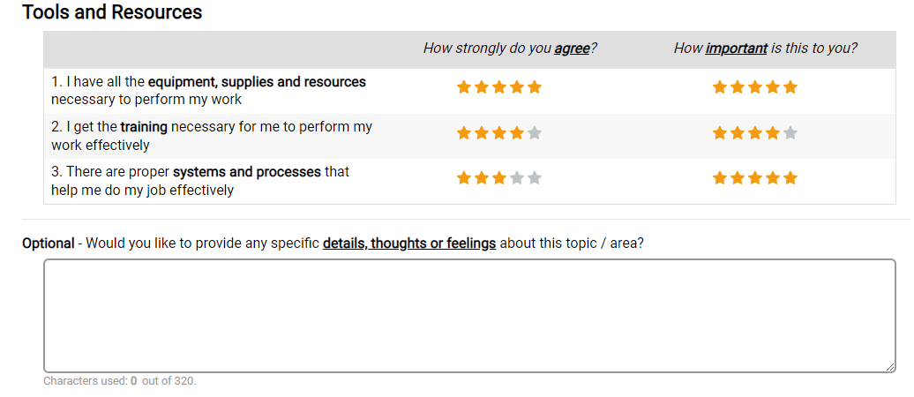
Survey Questions
“You will be asked to provide ratings of the organization
and how important certain topics/areas are for you.”
Example:
Notes:
SG UPDATED - ADDED INSTRUCTIONS & SAMPLE ITEM TO EXISTING SLIDE

Slide 22
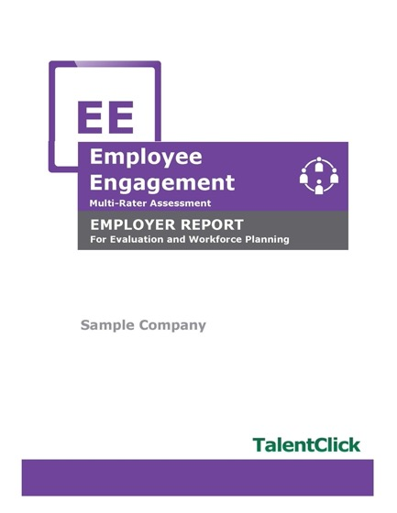
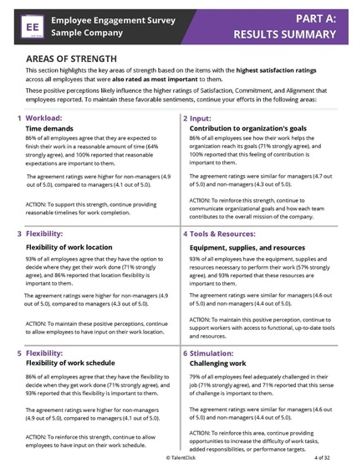
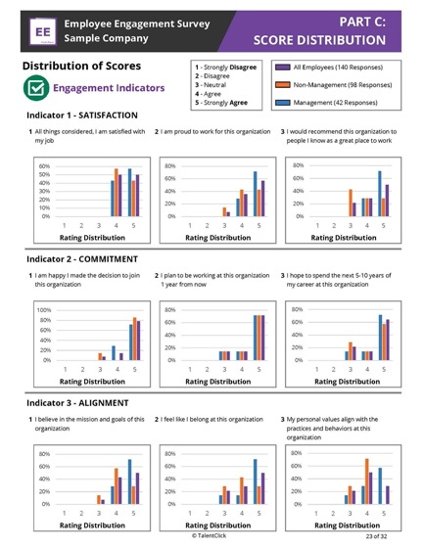
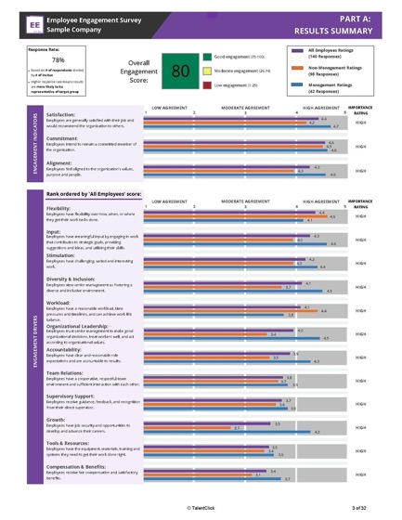
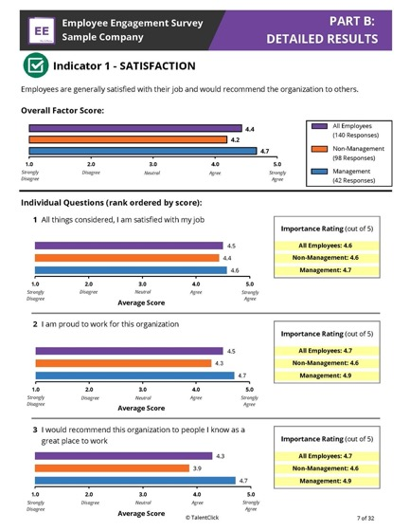
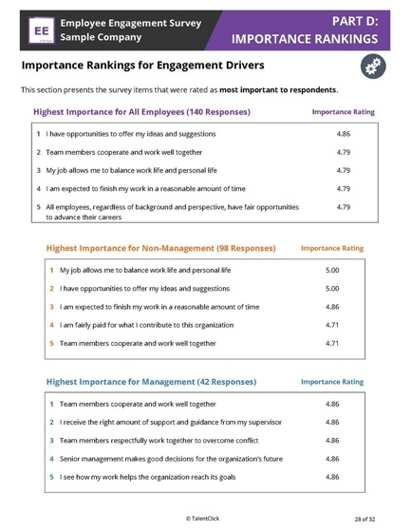
Employee Engagement Report

Slide 23
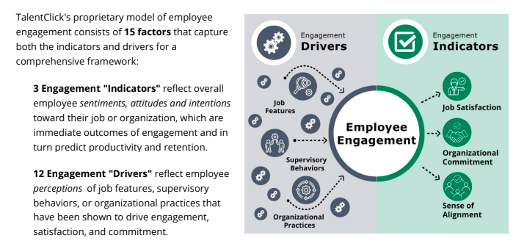
TalentClick’s Model

Slide 24

What you receive:
Summary of Results with Engagement Score
Executive Summary of top strengths and areas for improvement with suggested action steps
Detailed Results & Score Distributions
Importance Rankings for Engagement Drivers
Appendix with Open-Ended Responses

Slide 25
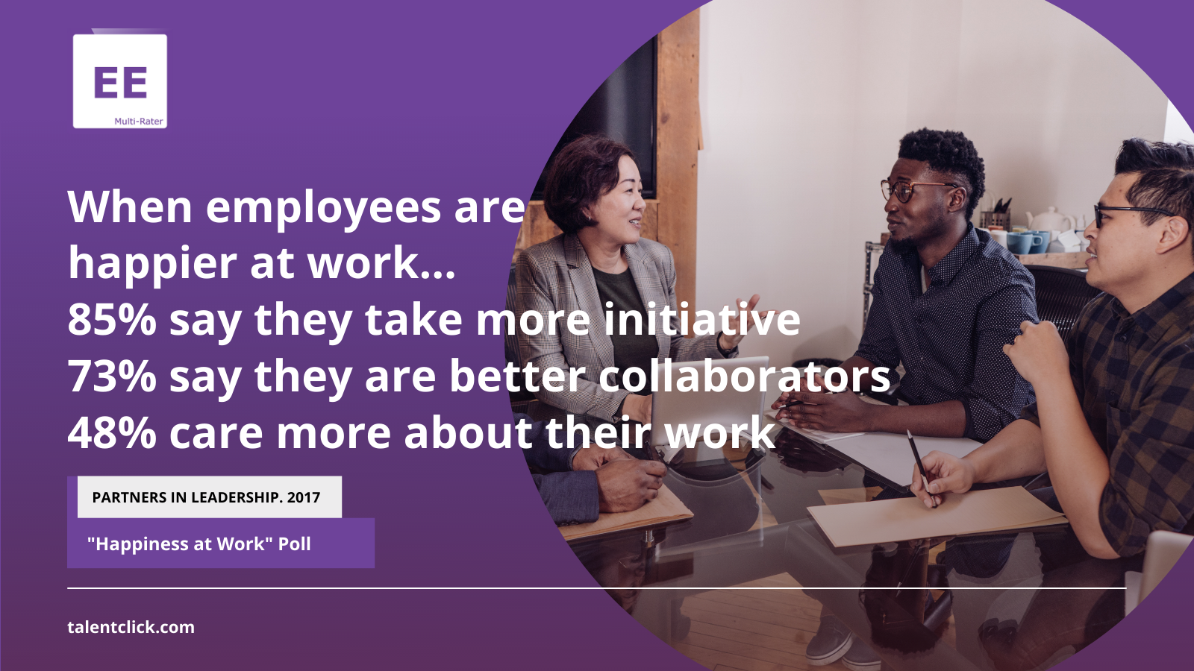

Slide 26
Sample Pricing
Workforce Size (# Employees sent survey link) | Cost for 1st Employee Survey each year | Annual Admin & Maintenance Fee | TOTAL RETAIL CHARGE
50 | $1,625 | $1,000 | $2,625
100 | $3,084 | $1,000 | $4,084
500 | $10,509 | $1,000 | $11,509
1,000 | $14,437 | $1,000 | $15,437
5,000 | $39,869 | $1,000 | $40,869
Notes:
Pricing is based on total # employees Client wants EE Survey link sent to.
Prices are in US Dollars (USD). Any applicable taxes are extra.
$1,000/yr Admin fee is for set up of annual survey, compiling invitation list, sending emails, tracking completions, sending reminders, producing 1 master report per year, conducting 1 half-hour debrief meeting, 30 days’ notice.
Contract renews automatically each year unless Customer provides min. 30 days notice.
Add $500 for admin and reporting on each specific group (business unit, division, location, department, team, role)
Customization of surveys and/or reports at consulting rate of $225/hr
Intermittent surveys (semi annual, quarterly) are available. Contact us.

Slide 27

Next Steps
Pricing
Contract Approval
Planning & Setup

Slide 28

Questions?
TalentClick
info@talentclick.com
1.877.723.3778
YOUR NAME HERE
Your contact details here

