Slide 1
Employee Engagement Survey
Discover what your employees really think!
YOUR CONTACT DETAILS HERE
YOUR LOGO HERE

Slide 2


Slide 3


Slide 4

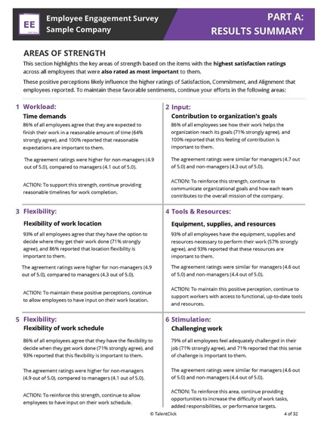
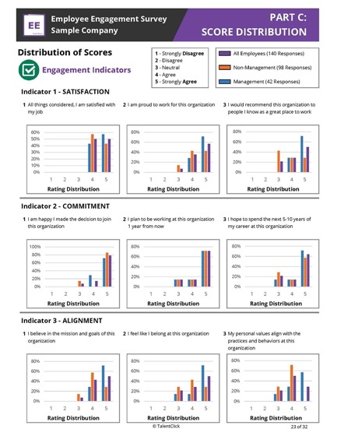
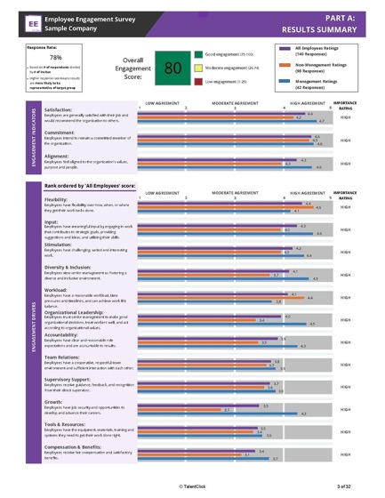
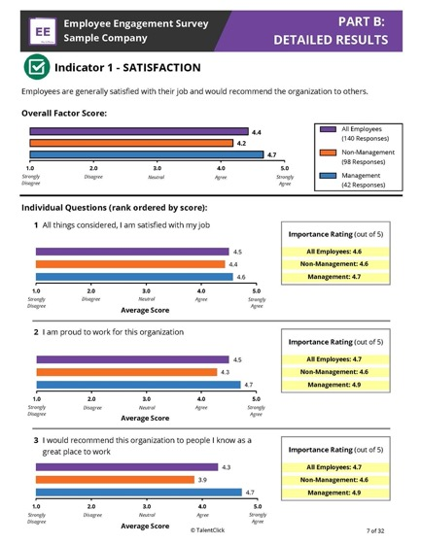
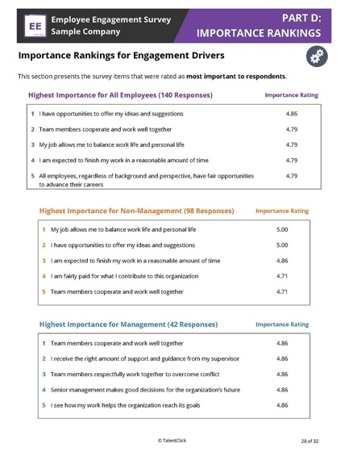
Employee Engagement Report

Slide 5
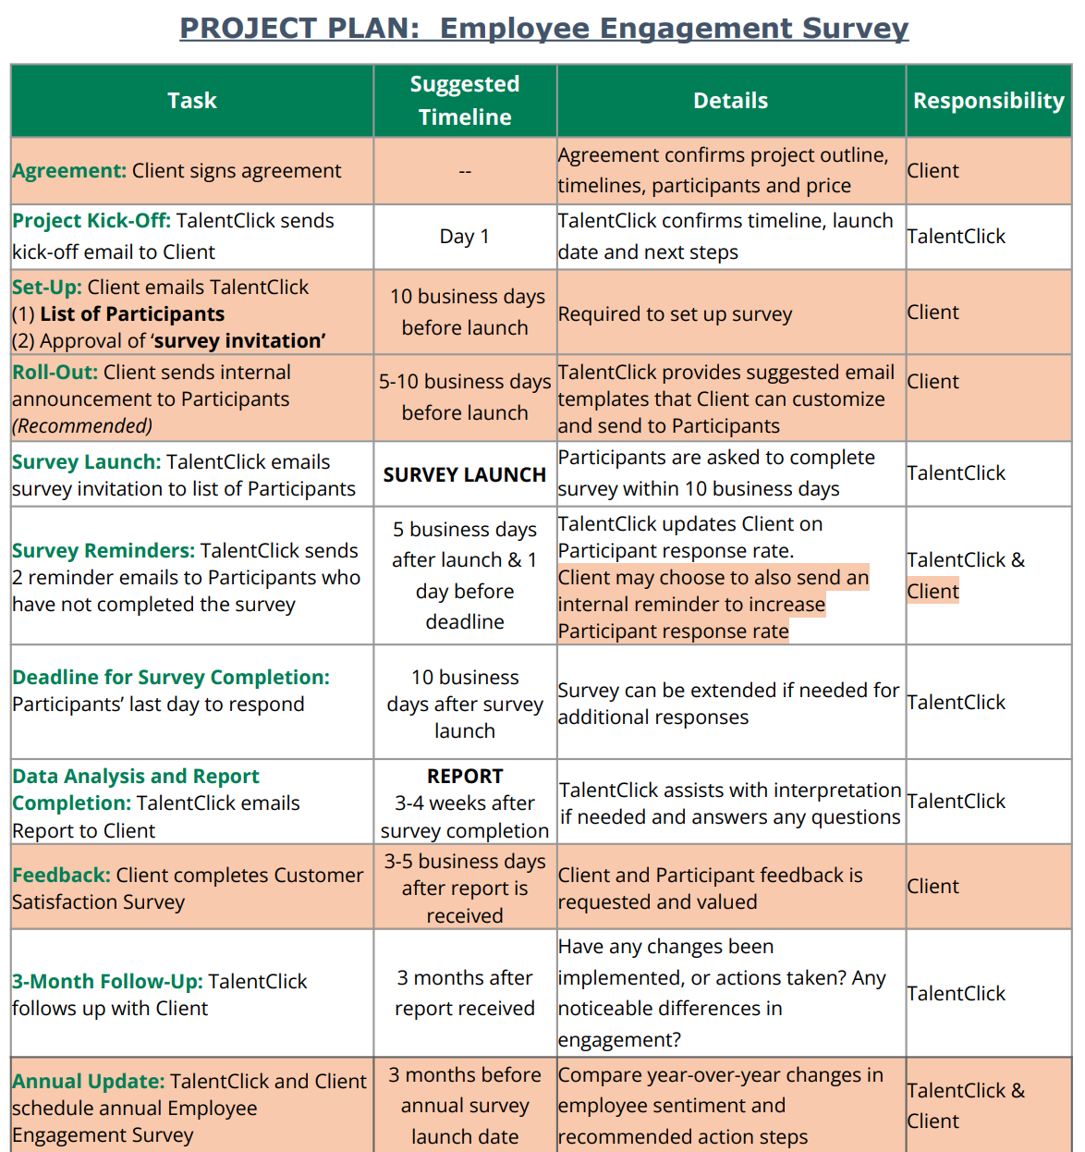
Get started!
1. Send Us List of Participants
2. Review ‘Survey Invite’
3. Confirm Timelines
List of email addresses for all employees who you wish to participate
Advise if you require any updates to TalentClick’s standard messaging
Let us know when you want the survey invite to send and let us do the rest!
Notes:
SG ADDED - OPTION 2 (SAME CONTENT) - SKIPPED
NOTE: My timelines said report within 10 business days after survey completion; however, the updated agreement says “within 21 business days.”

Slide 6
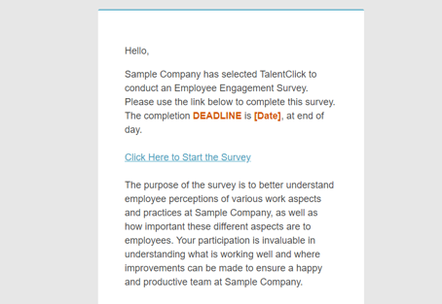
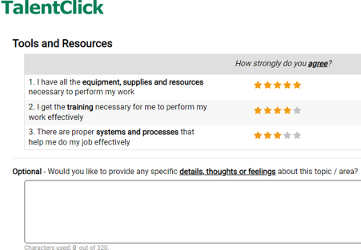
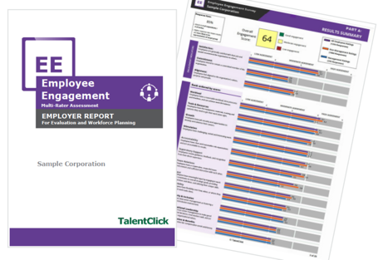
How Does it Work?
1.
2.
3.
Invite Participants
TalentClick sets up automated email campaign to send survey invites (& reminders) to all chosen participants
Participants Complete Survey
Online (computer, tablet or phone)
12-15 minutes
Available in 6 languages
Confidential
Get Results!
Results within 21 business days
Comprehensive master report & appendix with open-ended feedback
Notes:
SG ADDED (TO REPLACE SKIPPED SLIDE BELOW)
NOTE - Could add 4th step, before results (Track completion & send reminders)

Slide 7
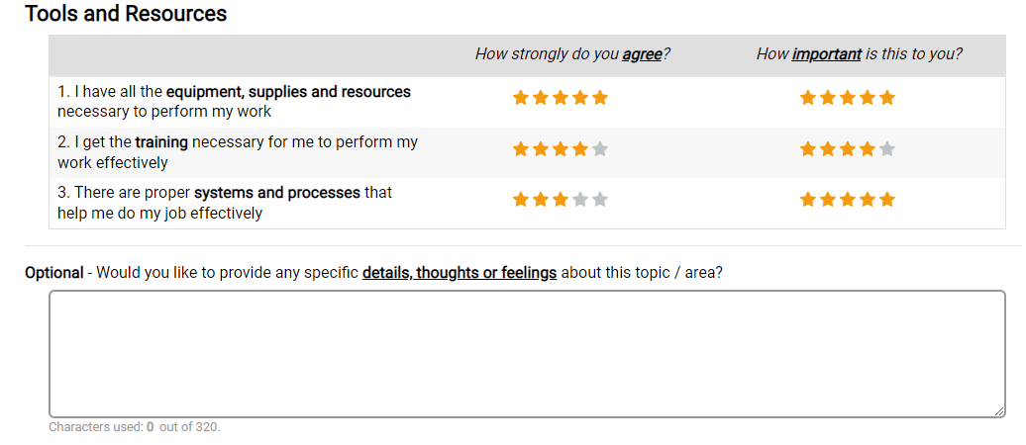
Employees Answer Survey Questions
“You will be asked to provide ratings of the organization
and how important certain topics/areas are for you.”
Example:
Notes:
SG UPDATED - ADDED INSTRUCTIONS & SAMPLE ITEM TO EXISTING SLIDE

Slide 8


What You Receive:
Summary of Results with Engagement Score
Executive Summary of top strengths and areas for improvement with suggested action steps
Detailed Results & Score Distributions
Importance Rankings for Engagement Drivers
Appendix with Open-Ended Responses

Slide 9
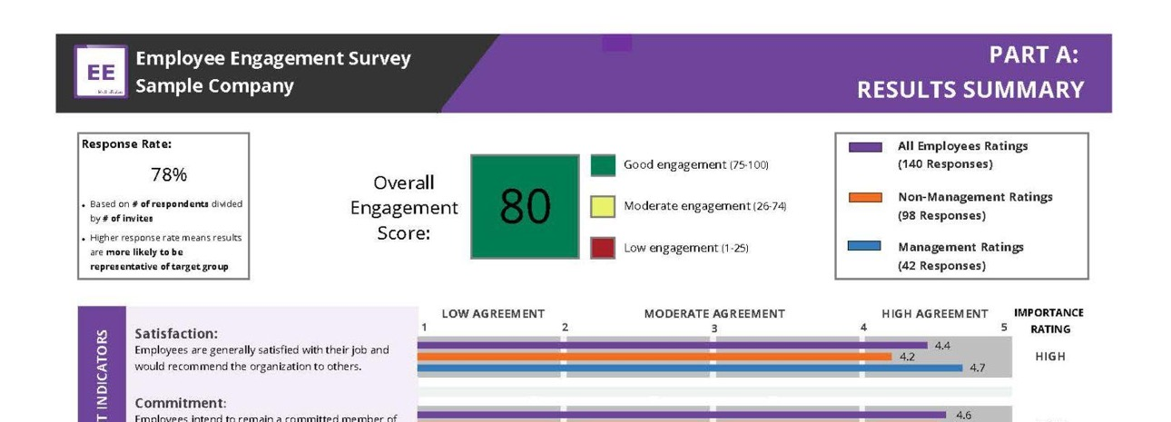
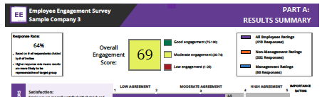
Easy to Interpret Reports

Slide 10



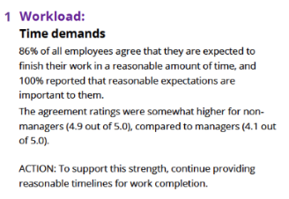
Discover Priorities AND Action Items
Participant Ratings
Group Differences
Recommendations

Slide 11
Sample Pricing
Workforce Size (# Employees sent survey link) | Cost for 1st Employee Survey each year | Annual Admin & Maintenance Fee | TOTAL RETAIL CHARGE
50 | $1,625 | $1,000 | $2,625
100 | $3,084 | $1,000 | $4,084
500 | $10,509 | $1,000 | $11,509
1,000 | $14,437 | $1,000 | $15,437
5,000 | $39,869 | $1,000 | $40,869
Notes:
Pricing is based on total # employees Client wants EE Survey link sent to.
Prices are in US Dollars (USD). Any applicable taxes are extra.
$1,000/yr Admin fee is for set up of annual survey, compiling invitation list, sending emails, tracking completions, sending reminders, producing 1 master report per year, conducting 1 half-hour debrief meeting, 30 days’ notice.
Contract renews automatically each year unless Customer provides min. 30 days notice.
Add $500 for admin and reporting on each specific group (business unit, division, location, department, team, role)
Customization of surveys and/or reports at consulting rate of $225/hr
Intermittent surveys (semi annual, quarterly) are available. Contact us.

Slide 12

Results of Better
Engagement
✓ Happier Employees.
✓ Improved morale. Better culture.
✓ Decreased employee turnover.
✓ Reduced costs of hiring, training.
✓ More time for other duties.
✓ Increased productivity/profitability.
✓ Enhanced employer brand.

Slide 13

Questions?
TalentClick
info@talentclick.com
1.877.723.3778
YOUR NAME HERE
Your contact details here

