Slide 1
A Fast, Easy, Affordable Way to Reduce Employee Turnover
YOUR NAME HERE
JOB TITLE Phone: 1.234.567.8910
Email: name@company.com
How Leading Companies are Hiring & Training High Performers using Psychometrics from TalentClick
Notes:
Add images - different titles
Different job roles images
Printed version

Slide 2
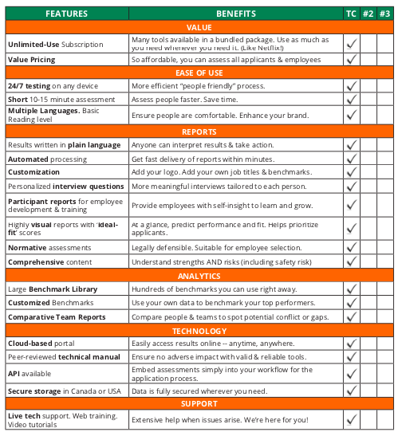
Why Choose
TalentClick?
We are the only vendor offering ALL of these features and benefits!
We’ll send this Assessment Vendor Selection Checklist
to you.
But for now,
let’s dive in and explore this together!

Slide 3
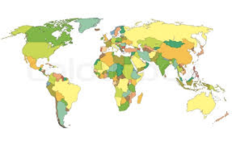
Who is TalentClick?
A Global leader in Psychometrics, used by thousands of business leaders in more than 100 countries worldwide, in 25 languages.

Slide 4
TalentClick Clients

Slide 5
Benefits to Employers
Increase POSITIVE events:
Decrease Negative events:
Better people = better culture
Improved employee retention
Increased productivity/profitability
Enhanced brand
Save time for other duties
Save money
Decreased employee turnover
Fewer customer complaints
Less negative publicity
Less disruption of culture
Reduced incidents
Decreased training costs

Slide 6
The Problem
Traditional unstructured interviewing has a 50% success rate in hiring people who become ‘good’ or ‘high’ performers.
Employee turnover costs
(equal to 1 year's salary and benefits)
Source: PWC/Saratoga

Slide 7
The Solution
Move assessments further AHEAD (earlier) in your hiring process.
We make it affordable enough that employers can test all qualified applicants, before ‘confirmation bias’ can set in.

Slide 8
The Impact
Businesses that use pre-employment assessments are 36% more likely than all others to be satisfied with new hires
Source: Pre-Hire Assessments: An Asset for HR in the Age of the Candidate, Zach Lahey, Aberdeen Research, 2015
Using assessments to hire top performers who ‘fit’ yields up to 67% higher productivity and profit
Source: McKinsey Quarterly, Nov 2009

Slide 9
Our Solutions
Attitudes & Values Profile
A combination of our four most popular assessments
Driver Safety Quotient
Understand a driver’s likelihood of crashes, traffic violations and more
Workstyle & Performance Profile
Assesses workstyle, strengths and areas for improvement
Leadership Profile
Identify leadership capabilities, business reasoning and conflict management
Work Values & Attitude
Predict conformity, responsibility, coachability, positivity and more
Cognitive Quotient
Test spatial reasoning, language, and numerical problem-solving ability
Safety Quotient
To identify people with higher risk tolerance. Decrease human error and incidents
English Proficiency
Measure English language competencies, writing, vocabulary and typing accuracy
We are a leader in affordable psychometrics (behavioral assessments) for all levels of an organization.

Slide 10
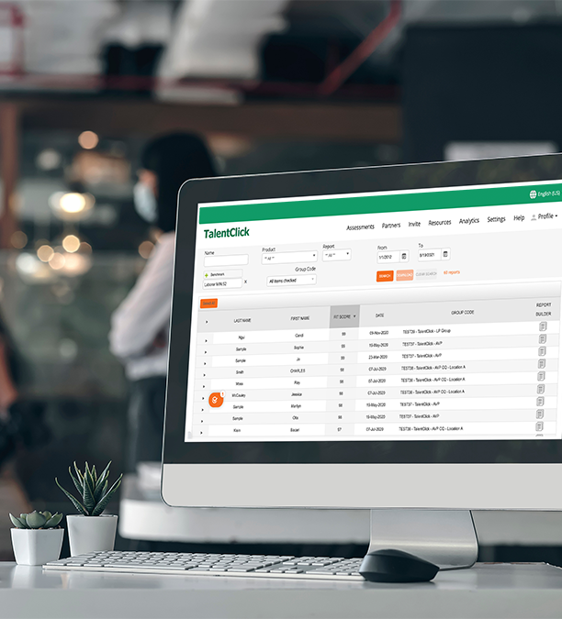
The TalentClick
Portal
Secure Storage & Advanced Analytics
Easy, on-demand Report Dashboard
Take assessment results to the next level with Team Analytics & the Report Builder
The Fit Score Sorter helps rank applicants based on job fit to save your time
Identify high potential applicants you might have overlooked to screen in candidates

Slide 11
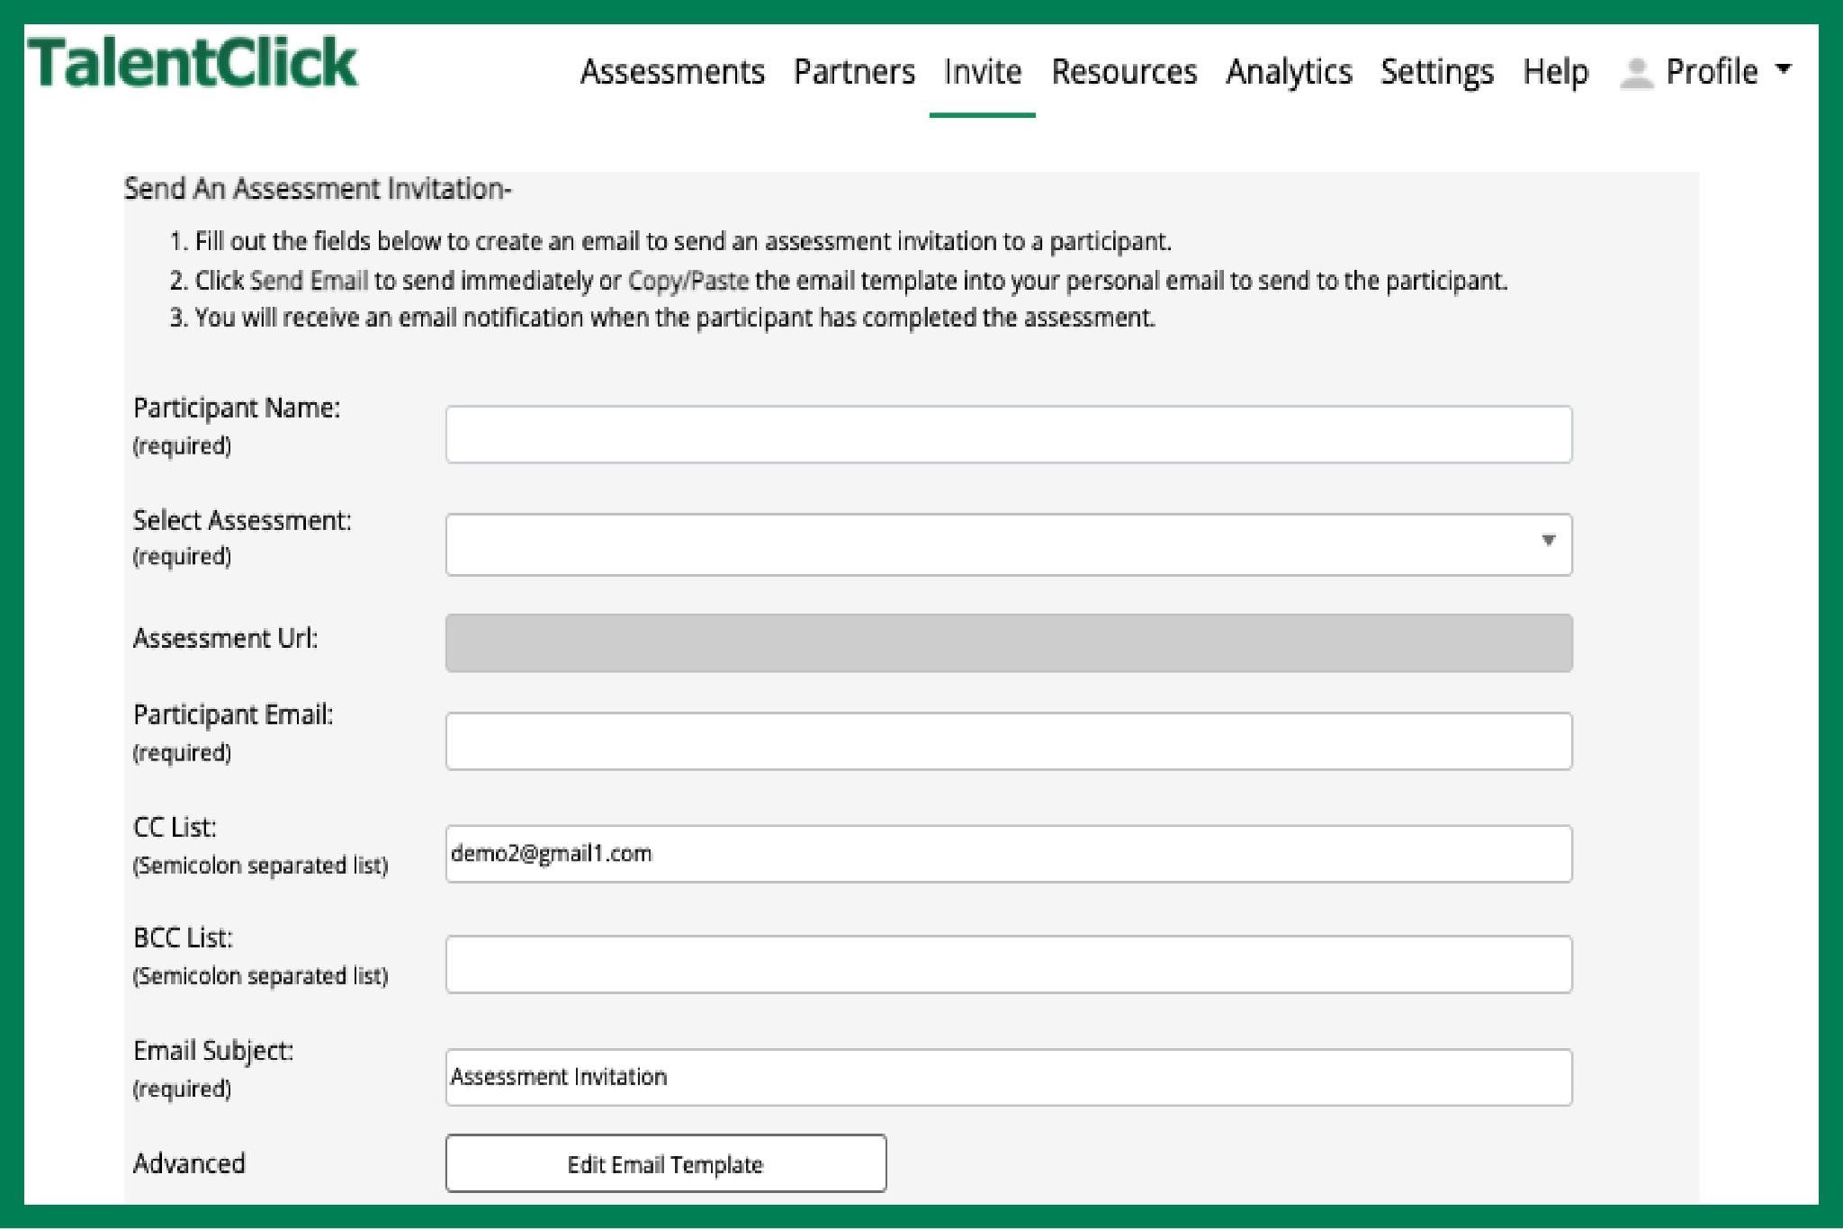
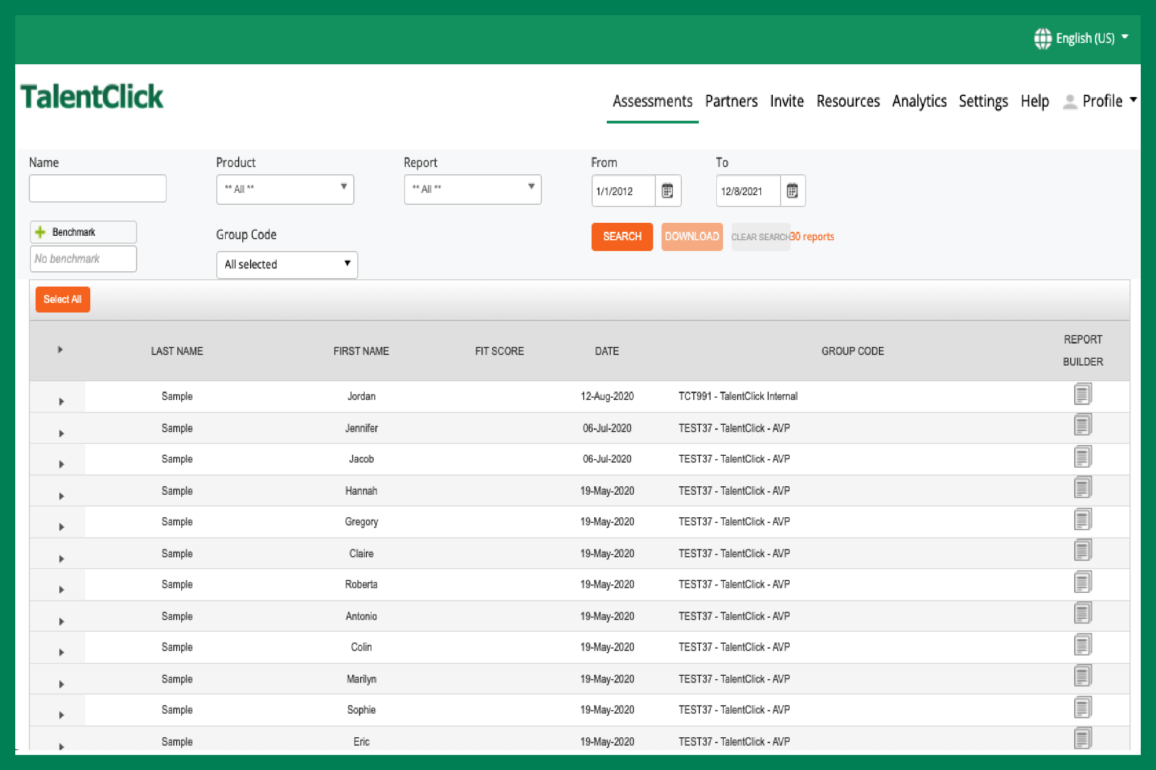
Input: Assessment Process
Invites Applicants
•auto-send or manually email link
•post link on Job Portals, your ‘Careers’ page
Participants Complete Assessment
• 5 to 15 minutes online
• 25+ languages
•basic reading level
•non-invasive
•no adverse impact
Get Results!
1. Reports automatically stored in your account on our cloud-based platform
2. Emailed as PDFs
3. Integrate with your ATS

Slide 12
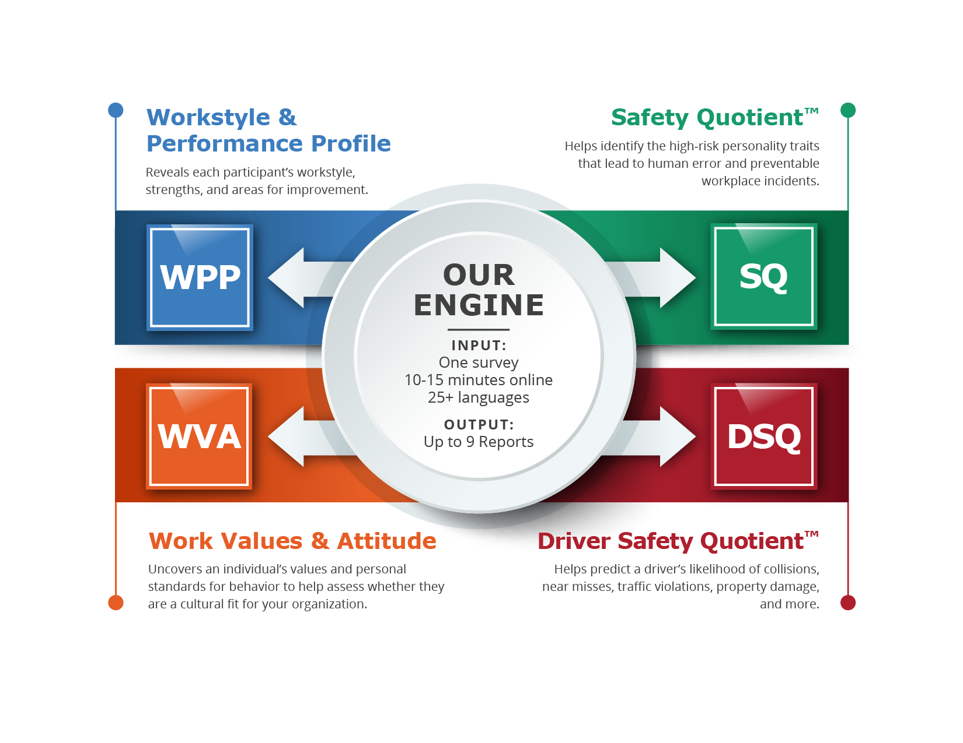
Output: Various Reports
From one test, you can choose many reports!

Slide 13
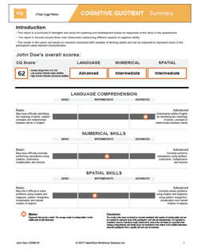
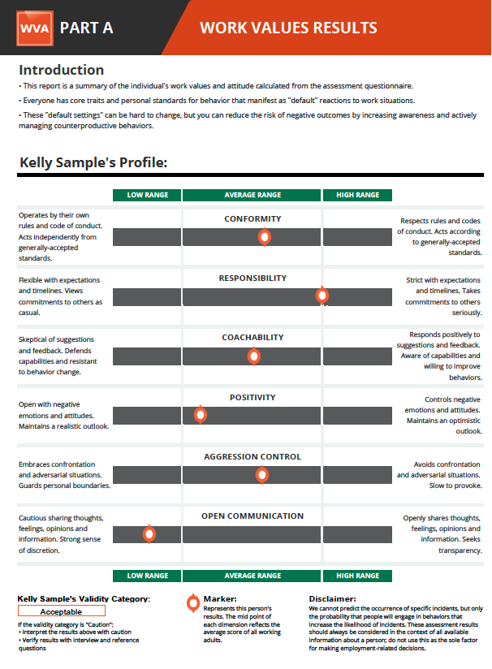
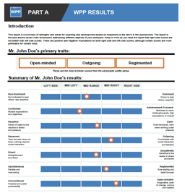
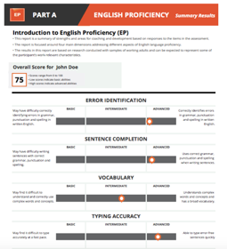
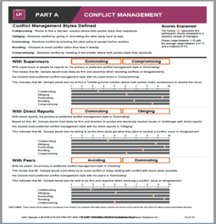
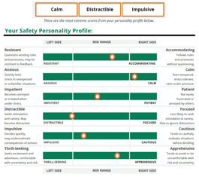
Report Format
Short reports. Highly visual. Easy-to-interpret results in plain language. No certification required!

Slide 14
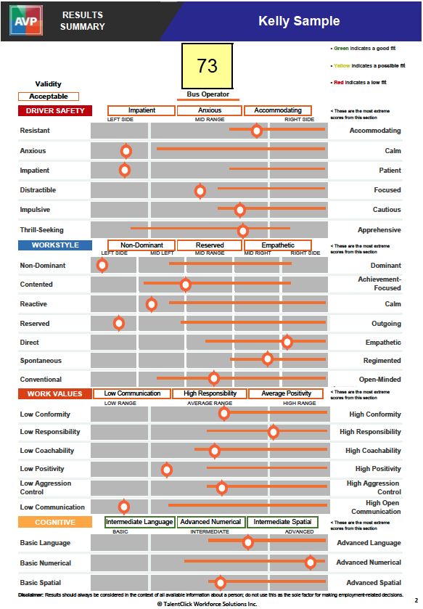
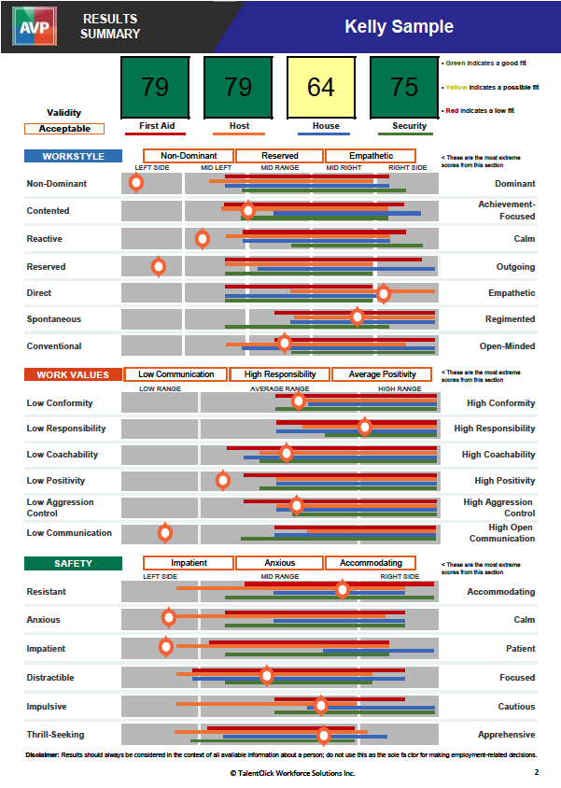
Page 1: Benchmarked ‘Ideal Fit’ Score
’Ideal fit’ scores let you see, at a glance, how likely an applicant is to be a high performer.
Helps save time when sorting resumes and prioritizing applicants to interview.

Slide 15
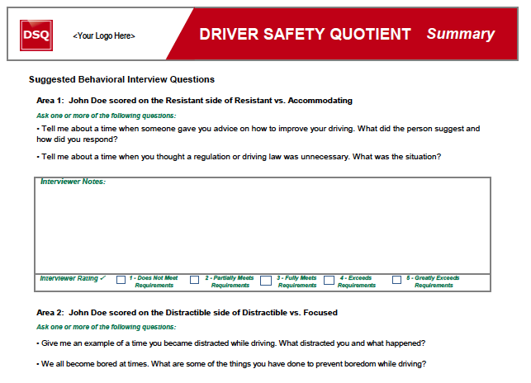
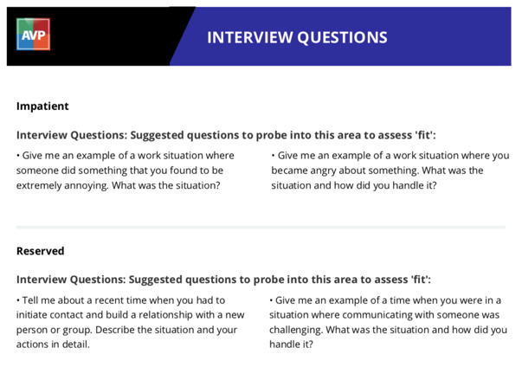
Page 2: Personalized Interview Questions
Interview questions are personalized to each individual’s results.
This leads to more insightful interviews!

Slide 16
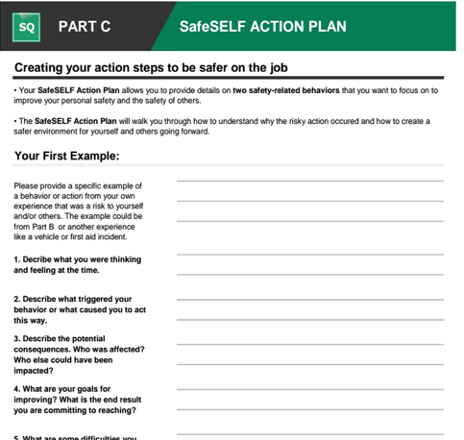
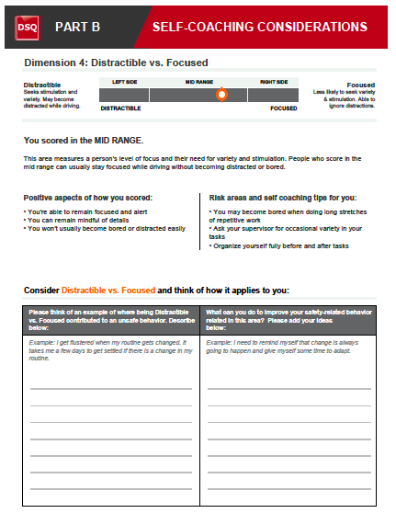
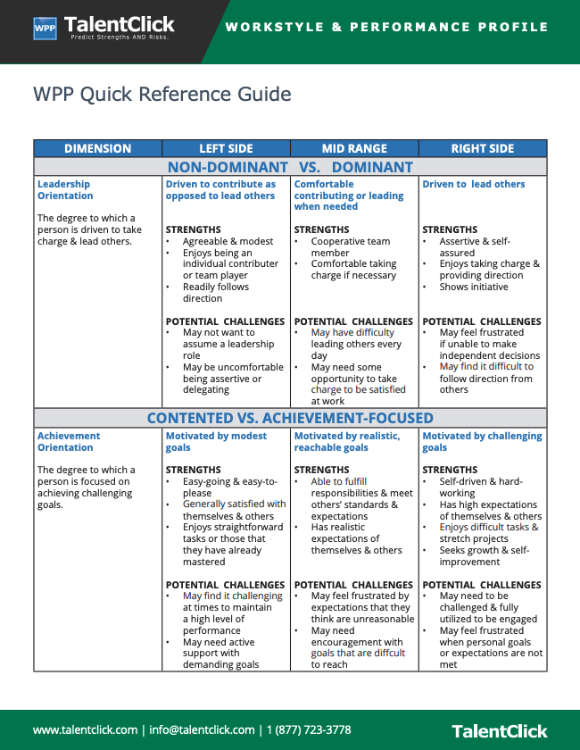
Page 3: Employee Training & Coaching (optional)
Practical coaching tools for supervisors and employees

Slide 17
Proven Validity & Reliability
MEASURE | Professional Standards (0.00 to 1.00) | TalentClick Assessments
RELIABILITY (test-retest and internal consistency reliability) | 0.70 | 0.75 to .86
VALIDITY (construct and content validity) (score = 0.00 or 1.00) | 1.00 | 1.00
VALIDITY (criterion-related) (correlation coefficients) | 0.11 | 0.15 to 0.32 * varies across dimensions
ETHICS, FAIRNESS & CONFIDENTIALITY (score = 0.00 or 1.00) | 1.00 | 1.00
PRACTICALITY & EFFICIENCY (score = 0.00 or 1.00) | 1.00 | 1.00
EEOC UNIFORM GUIDELINES AVOIDANCE OF ADVERSE IMPACT (score = 0.00 or 1.00) | 1.00 | 1.00

Slide 18
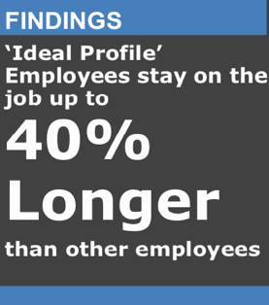
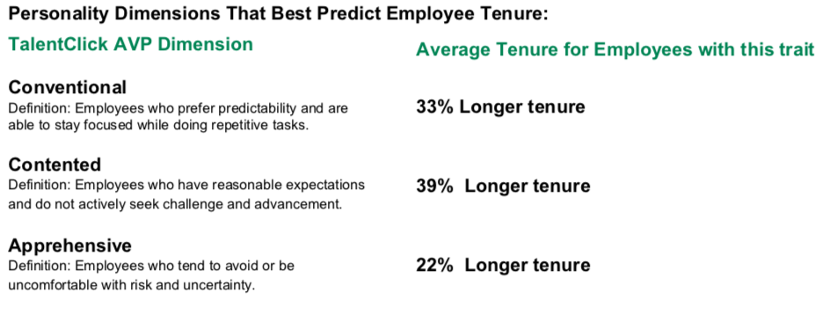
Research Study Example
Employee Turnover

Slide 19
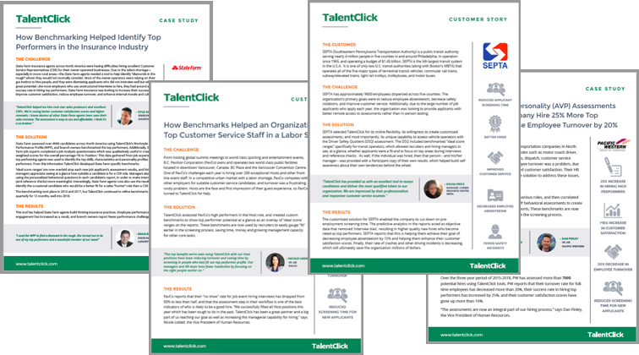
Customer Case Studies

Slide 20
Superior Customer Satisfaction
“These reports exceeded my expectations. They were spot on... totally nailed it, very insightful.”
-Senior Manager, EPCOR Utilities
“I’d rate TalentClick a 10 out of 10. The product is great and the service has been exemplary.”
-Harriet Robinson, Vice President HR
“I have been waiting for a product like this my whole career.” -Christine Trombley, HR Manager, Zavcor Transportation
“We consider the tool an incredibly important part of our screening process.” –Dan Finley, VP HR, PWT
97%
Customer Satisfaction
score

Slide 21
TalentClick Pricing Levels
Annual Unlimited-Use Subscriptions
BASIC
Free (1 account per company)
ASSESSMENTS & REPORTS
Attitude-Values-Personality (AVP)
One page Employer Summary Report for:
Workstyle & Performance Profile (WPP)
Work Values & Attitude (WVA)
Safety / Driver Safety / Risk Taking (SQ)
TECHNOLOGY & SUPPORT
Basic access to our cloud-based portal
Self-serve training resources
STANDARD
Basic plus:
ASSESSMENTS & REPORTS
Attitude-Values-Personality (AVP)
Comprehensive Employer reports
Benchmarked ‘Ideal profile’ ranges
Fit scores for applicant screening
Participant reports
Cognitive Quotient (CQ)
English Proficiency (EP)
TECHNOLOGY & SUPPORT
Advanced access to our Cloud based portal includes:
Team Analytics
Report Builder
Sort function for ranking applicants
PREMIUM
Standard plus:
ASSESSMENTS & REPORTS
Leadership Profile (LP)
Conflict Management Style
Business Reasoning
Report Customization
Custom benchmarking of top performers
Job Analysis
Competency mapping
Additional professional consulting time
TECHNOLOGY & SUPPORT
API for integration with your HRIS/ATS
Notes:
Consider adding - # of benchmarks/job roles & number of training sessions?

Slide 22
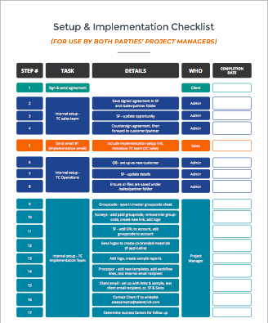
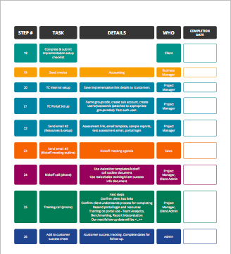
Getting Started: Account Setup
Phase 1:
You can be up and running within 3-5 days.
Phase 2:
Allow 60-90 days.

Slide 23
Takeaways
Test applicants earlier in the process.
Test all qualified applicants. (We make it so affordable, you can do that).
Benchmarking and ‘ideal fit’ scores will make it easy and fast to screen applicants.
You will be able to predict which applicants are the best fit. And you will decrease employee turnover by at least 25%.

Slide 24
Questions?
YOUR CONTACT INFO HERE

