Slide 1
A Fast, Easy, Affordable Way to Help Reduce Risk &
Human Error
YOUR NAME
COMPANY INFO
Contact Info
Notes:
Add images - different titles
Different job roles images
Printed version

Slide 2
What Do We Help With?

Slide 3
Problem
Employee turnover costs
(equal to 1 year's salary and benefits)
Source: PWC/Saratoga

Slide 4
More Problems
Cost of workplace violence:
$36 billion
http://www.businessinsider.com/surprising-costs-to-the-work-place-2011-11?op=1
Cost of workplace injuries:
$62 billion
2016 Liberty Mutual Workplace Safety Index
Cost of theft and fraud:
$600 billion
http://www.businessinsider.com/surprising-costs-to-the-work-place-2011-11?op=1

Slide 5
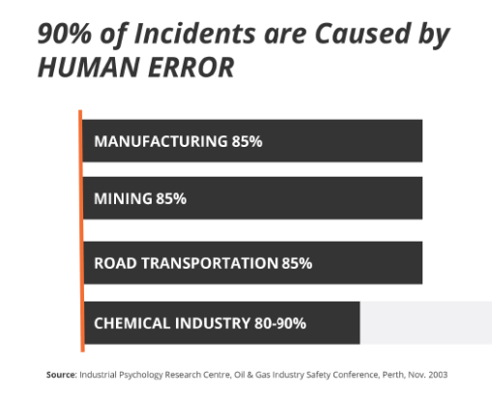
Causes of Workplace Incidents
Most incidents are NOT caused by equipment failure or improper SOPs. Most incidents are caused by people!
CONSTRUCTION 90-95%

Slide 6
Timeline of Incident Causation
HUMAN FACTOR
HIGH-RISK BEHAVIOR
INCIDENT

Slide 7
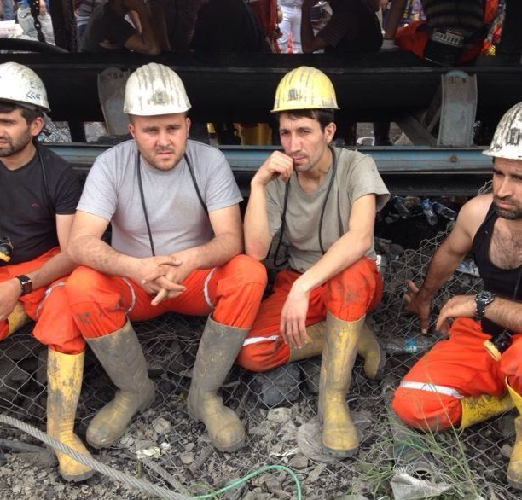
Workforce Problem
1 out of 4 workers has a greater risk of incidents
What if you could SPOT them ahead of time…before the incident took place?

Slide 8
Hiring Problem
Traditional unstructured interviewing has a 50% success rate in hiring people who become ‘good’ or ‘high’ performers.

Slide 9
Hiring Problem
During pre-employment screening and selection, background checks and reference checks are necessary!
But these tools focus on the PAST.

Slide 10
Solution
Move assessments further AHEAD (earlier) in your hiring process.
We make it affordable enough that employers can test all qualified applicants, before ‘confirmation bias’ can set in.

Slide 11
Impact
Businesses that use pre-employment assessments are 36% more likely than all others to be satisfied with new hires
Source: Pre-Hire Assessments: An Asset for HR in the Age of the Candidate, Zach Lahey, Aberdeen Research, 2015
Using assessments to hire top performers who ‘fit’ yields up to 67% higher productivity and profit
Source: McKinsey Quarterly, Nov 2009

Slide 12
Who is TalentClick?

Slide 13
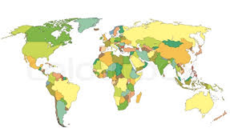
Who is TalentClick?
A Global leader in Psychometrics, used by thousands of business leaders in more than 100 countries worldwide, in 25 languages.

Slide 14
TalentClick Clients

Slide 15
Benefits to Employers
Increased POSITIVE events:
Decreased NEGATIVE events:
Better people = better culture
Improved employee retention
Increased productivity/profitability
Enhanced brand
Save time for other duties
Save money
Decreased employee turnover
Reduced incidents
Fewer injuries
Decreased property damage
Fewer customer complaints
Less negative publicity
Less disruption of culture

Slide 16
Broad Suite of Assessment Solutions
Attitudes & Values Profile
A combination of our four most popular assessments
Driver Safety Quotient
Understand a driver’s likelihood of crashes, traffic violations and more
Workstyle & Performance Profile
Assesses workstyle, strengths and areas for improvement
Leadership Profile
Identify leadership capabilities, business reasoning and conflict management
Work Values & Attitude
Predict conformity, responsibility, coachability, positivity and more
Cognitive Quotient
Test spatial reasoning, language, and numerical problem-solving ability
Safety Quotient
To identify people with higher risk tolerance. Decrease human error and incidents
English Proficiency
Measure English language competencies, writing, vocabulary and typing accuracy
We are a leader in affordable psychometrics (behavioral assessments) for all levels of an organization.

Slide 17
Where Safety Quotient
Fits in Org Processes
Pieces in the Safety & Risk Puzzle:
Equipment and Machinery
Standard Operating Procedures
Audits & Compliance Checklists
Communication Programs
Hiring
Training:
Technical / Skills Training
Safety Compliance Training
Soft Skills Training for Leaders
Soft Skills Training for Employees
Notes:
Today we will talk about the Safety Quotient, which is a personality assessment that predicts safety-related behavior and risk.
Here is a way that we can view where the SQ, or behavioral risk insights, fit into your existing organizational processes for a comprehensive safety program.
Of course, the right equipment and machinery, thorough procedures, audits and checks, communication and technical training are all crucial to ensure the safety of our workers.
However, a part of the ‘safety puzzle’ that is often overlooked is the role of the individual.
Thanks to decades of research, we now understand more about the effect that personality and individuals behavior have on safety - And we have seen a shift in philosophy taking place where there is a much greater emphasis on the individual in the safety equation.
So this can all be viewed as an additional piece to help build a safe workplace.
This may include considering the individual’s default-settings when hiring for potentially high-risk roles, as well as how to best train or manage workers based on their personal challenges or blind-spots to encourage safe behavior.
Other:
Incidents can be further reduced by taking into consideration the psychological makeup of the worker. Therefore, to create the most comprehensive, thorough overall safety climate, organizational leaders are now combining traditional safety methods with safety-based personality assessments.
Original Notes:
Thanks to decades of research, we understand more today about the effect that personality and behavior have on safety. A shift in philosophy - based on study results - places a much greater emphasis on the role of the individual in the safety equation. Why, for example, would we put a distractible personality type at the controls of dangerous equipment? Even the most extensive traditional safety program can’t remove that risk.

Slide 18
Proven Validity & Reliability
MEASURE | Professional Standards (0.00 to 1.00) | TalentClick Assessments
RELIABILITY (test-retest and internal consistency reliability) | 0.70 | 0.75 to .86
VALIDITY (construct and content validity) (score = 0.00 or 1.00) | 1.00 | 1.00
VALIDITY (criterion-related) (correlation coefficients) | 0.11 | 0.15 to 0.32 * varies across dimensions
ETHICS, FAIRNESS & CONFIDENTIALITY (score = 0.00 or 1.00) | 1.00 | 1.00
PRACTICALITY & EFFICIENCY (score = 0.00 or 1.00) | 1.00 | 1.00
EEOC UNIFORM GUIDELINES AVOIDANCE OF ADVERSE IMPACT (score = 0.00 or 1.00) | 1.00 | 1.00

Slide 19
Superior Customer Satisfaction
“These reports exceeded my expectations. They were spot on... totally nailed it, very insightful.”
-Senior Manager, EPCOR Utilities
“I’d rate TalentClick a 10 out of 10. The product is great and the service has been exemplary.”
-Harriet Robinson, Vice President HR
“I have been waiting for a product like this my whole career.” -Christine Trombley, HR Manager, Zavcor Transportation
“We consider the tool an incredibly important part of our screening process.” –Dan Finley, VP HR, PWT
97%
Customer
Satisfaction Score

Slide 20
What is Personality?

Slide 21
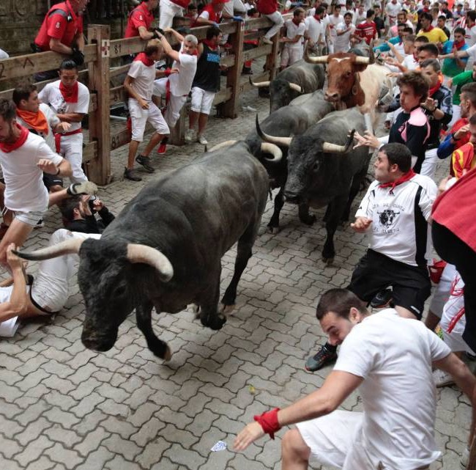
What is Your Reaction to This?
Some people are risk takers. Others avoid risk.

Slide 22
What is Your Reaction to This?
Some people are compliant with rules and authority.
Others are defiant and think rules apply to other people.

Slide 23
What is Personality?
‘Default settings’ or ‘hard-wiring’
Impulses or knee-jerk reactions
How we act when nobody is watching
Stable over time & resistant to change
Drives on-the-job behavior

Slide 24
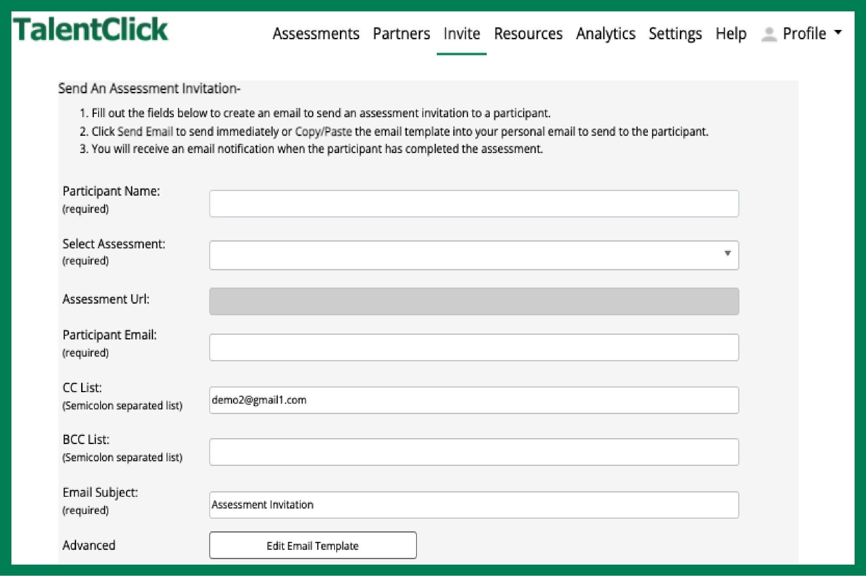
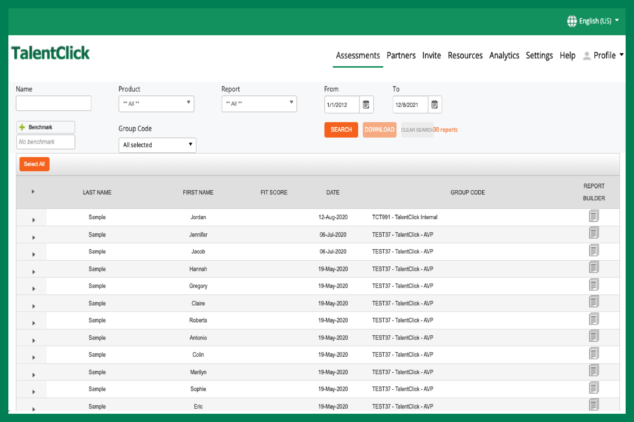
How Do We Measure Behavioral Risk?
Invites Applicants
•auto-send or manually email link
•post link on Job Portals, your ‘Careers’ page
Participants Complete Assessment
• 5 to 15 minutes online
• 25+ languages
•basic reading level
•non-invasive
•no adverse impact
Get Results!
1. Reports automatically stored in your account on our cloud-based platform
2. Emailed as PDFs
3. Integrate with your ATS

Slide 25
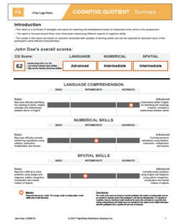
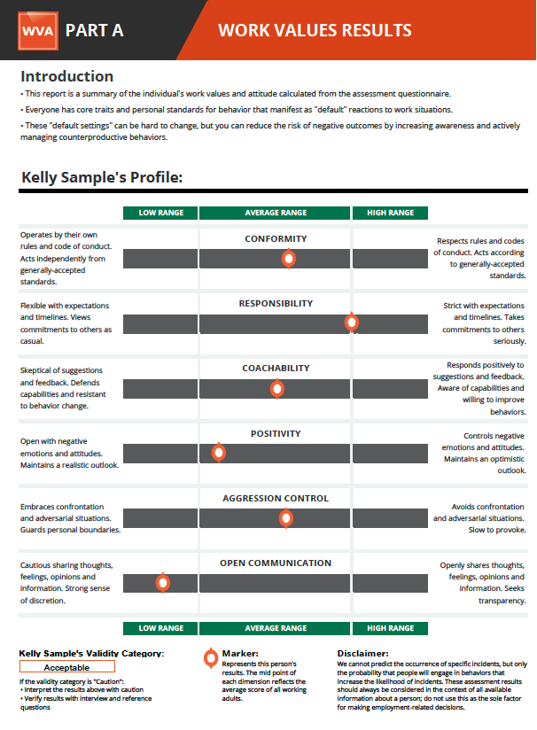
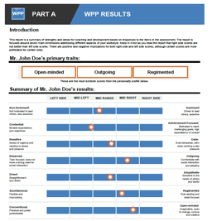
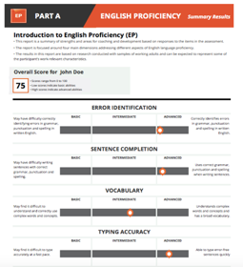
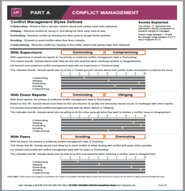
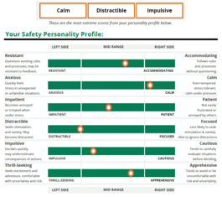
TalentClick Reports
Short reports. Highly visual. Easy-to-interpret results in plain language. No certification required!

Slide 26
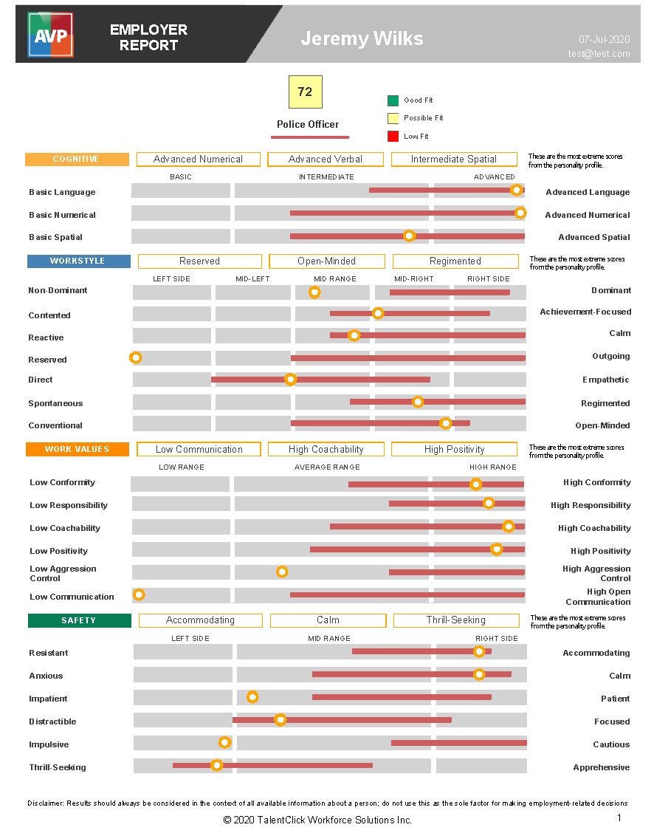
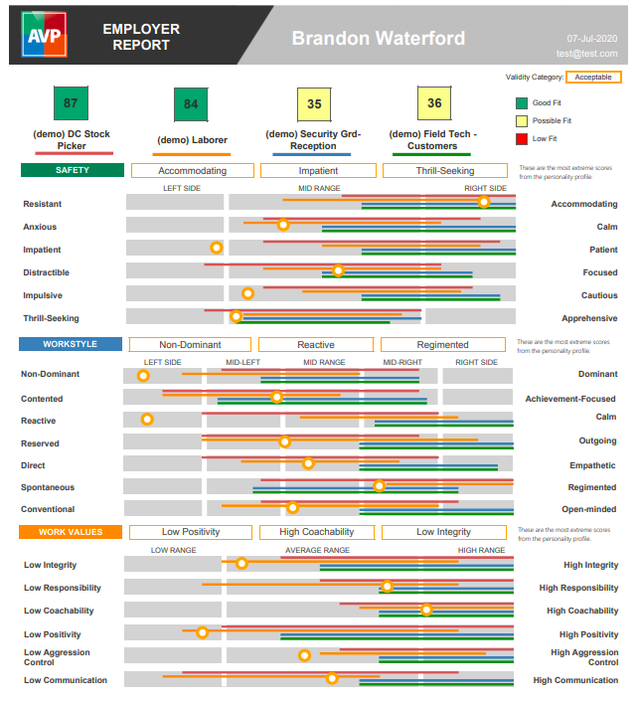
Benchmarks and ‘Ideal Fit’ Scores
’Ideal fit’ scores let you see, at a glance, how likely an applicant is to be a high performer.
Helps save time when sorting resumes and prioritizing applicants to interview.

Slide 27
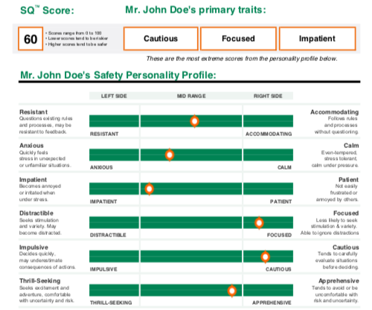
Employer Report Page 1: Summary
Key Features:
Safety Snapshot
Coaching Tips
SafeSELF Action Plan
www.talentclick.com
Notes:
The first part of every report shows the employee’s Safety Snapshot, a summary of their Safety Personality by each of the six dimensions:
Resistant vs. Accommodating
Anxious vs. Calm
Impatient vs. Patient
Distractible vs. Focused
Impulsive vs. Cautious
Thrill-Seeking vs. Apprehensive
For details of each dimension, ask Dean @ TalentClick for a sample report.

Slide 28
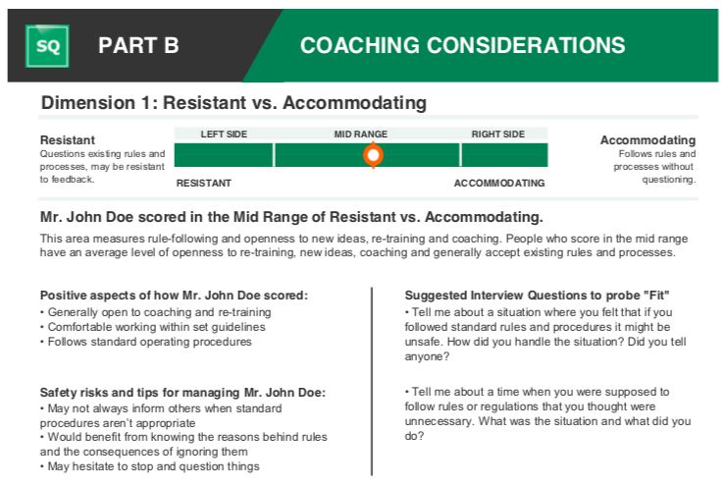
Page 2: Personalized Interview Questions
Interview questions are personalized to each individual’s results.
This leads to more insightful interviews!

Slide 29
Page 3: Management Advice & Coaching Tips
Coaching tips are personalized to each individual’s results.

Slide 30
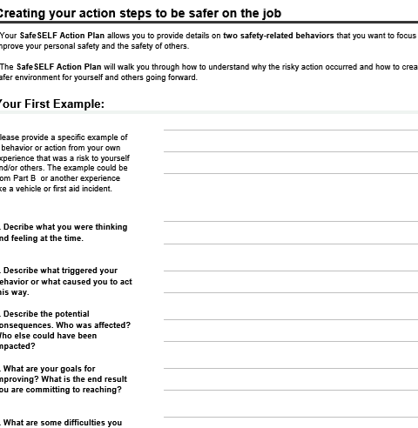
Participant Report
You can give each employee their own Participant report to help them gain self-awareness about their own ’hard wired’ personality.
Self-coaching advice helps them interrupt the typical knee-jerk reactions and instead choose lower–risk behaviors.

Slide 31
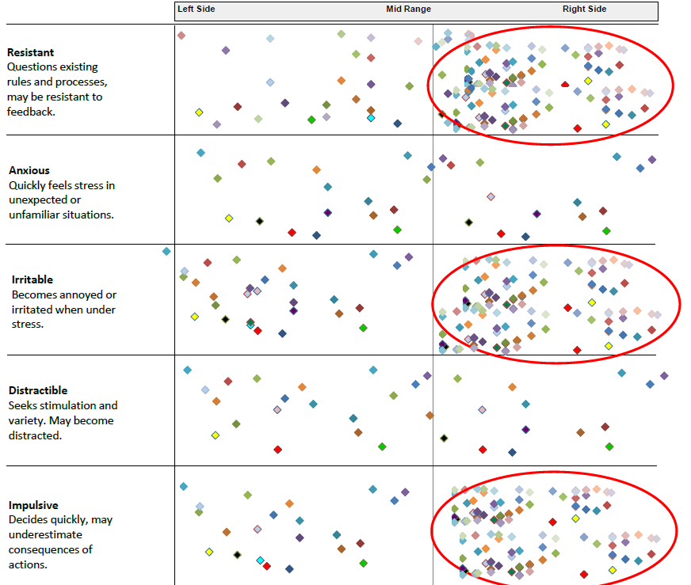
Group Report
Fewer First Aid Incidents & Recordable injuries
Fewer First Aid Incidents & Near Misses
Fewer First Aid Incidents & Recordable injuries
Notes:
This is what the report looks like. We’ll talk later about the specific dimensions, but for now, you can see there are 5 areas that we measure: Rule Resistance
Anxiety or Nervousness
Irritability
Distractibility
Impulsiveness
Why do we measure these 5 dimensions?
Decades of research has shown that these are the 5 personality dimensions that have been most strongly linked to incident causation. (as we saw earlier, up to 90% of workplace incidents/injuries are the result of human error, so wouldn’t you say there’s value in highlighting individual’s risk areas?)
Other FAQs:
Can it be faked? Our assessments are very difficult for people to fake. First, the survey questions are non-transparent i.e., it is very difficult to know which answers will lead to more favorable scores. Second, the assessment has built-in measures for the gauging likelihood that a person is answering dishonestly. (This is called motivational distortion).
Will the results be used as a "pass" or "fail"? Any personality assessment should be used as just one of the sources of information to be used in hiring and employee development rather than being used as a pass/fail or sole factor for an employment-related decision.
How scientifically accurate and reliable is this? If you like stats and data, then we can provide a full Technical Manual for you. [Note to facilitator: Sometimes there is “that guy” in the room who will ask for something more, so here are the facts: Criterion-related Validity: r values in the .2 to .3 range and statistically significant at the p=<.01 level. When talking about Reliability of the SQ dimensions measured by internal consistency, Reliability: r values exceed .75 and statistically significant at the p=<.01 level. But don’t try to be an expert in this area. Just tell them that you’ll refer questions about research methodology to TalentClick].
Are there case studies? Yes, there is plenty of research showing the correlation between personality risk and actual incidents in the workplace. In the next few slides, we’ll present a few.

Slide 32
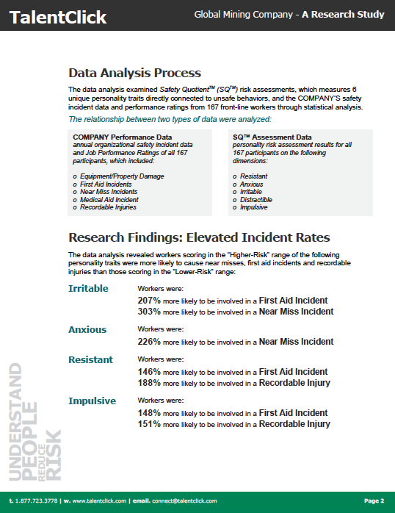
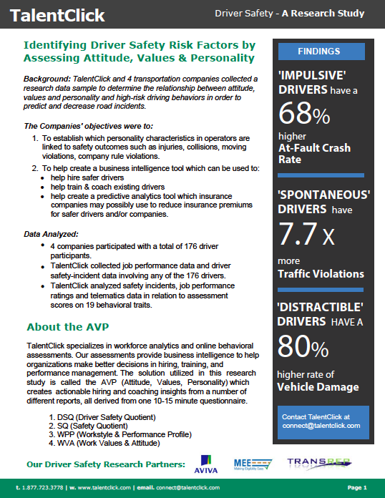
Research Studies

Slide 33
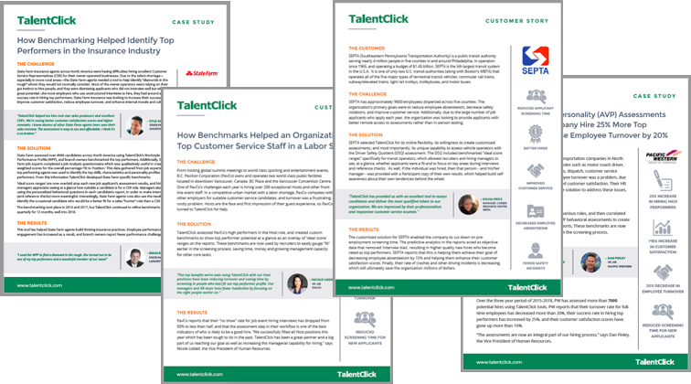
Case Studies

Slide 34
Takeaways
Test applicants earlier in the process.
Test all qualified applicants. (We make it so affordable, you can do that).
Benchmarking and ‘ideal fit’ scores will make it easy and fast to screen applicants and select lower-risk employees.
You will improve your risk-related metrics by at least 25%, which will help you save time, save money, and make money!

Slide 35
Questions?
Greg Ford, M.Ed Workplace Learning, BA Psych
Managing Partner
Phone: 1.877.723.3778 Email: Info@TalentClick.com

