Slide 1
A Fast, Easy, Affordable Way to Reduce Safety Risk
Greg Ford, M. Ed Workplace Learning, B.A Psych
President & CEO Phone: 1.877.723.3778 Email: info@talentclick.com
How Leading Companies are Hiring & Training Lower Risk
Employees Using TalentClick
Notes:
Add images - different titles
Different job roles images
Printed version

Slide 2
Who is TalentClick?

Slide 3
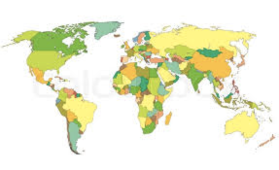
Who is TalentClick?
A Global leader in Psychometrics, used by thousands of business leaders in more than 100 countries worldwide, in 25 languages.

Slide 4






TalentClick Clients

Slide 5
Objectives & Results
Decrease
NEGATIVE events:
Reduced employee turnover
Reduced incidents, injuries
Decreased property damage
Less workplace violence, harassment
Less theft and fraud
Fewer customer complaints
Less negative publicity
Less disruption of culture

Slide 6








Broad Suite of Assessment Solutions
Attitudes & Values Profile
A combination of our four most popular assessments
Driver Safety Quotient
Understand a driver’s likelihood of crashes, traffic violations and more
Workstyle & Performance Profile
Assesses workstyle, strengths and areas for improvement
Leadership Profile
Identify leadership capabilities, business reasoning and conflict management
Work Values & Attitude
Predict conformity, responsibility, coachability, positivity and more
Cognitive Quotient
Test spatial reasoning, language, and numerical problem-solving ability
Safety Quotient
To identify people with higher risk tolerance. Decrease human error and incidents
English Proficiency
Measure English language competencies, writing, vocabulary and typing accuracy
We are a leader in affordable psychometrics (behavioral assessments) for all levels of an organization.

Slide 7


Where We Fit in Org Processes
Pieces in the Safety & Risk Puzzle:
Equipment and Machinery
Standard Operating Procedures
Audits & Compliance Checklists
Communication Programs
Hiring
Training
Technical / Skills Training
Safety Compliance Training
Soft Skills Training for Leaders
Soft Skills Training for Employees
Notes:
People are not blank slates. Thanks to decades of research, we understand more today about the effect that personality and behavior have on safety, including driver behavior. A shift in philosophy based on study results places a much greater emphasis on the role of the individual in the safety equation. Why, for example, would we put a distractible personality type at the controls of dangerous equipment? Even the most extensive traditional safety program can’t remove that risk.
It’s true that traditional safety methods can help people become safer. But a crucial part of the safety puzzle has been missing. Incidents can be further reduced by taking into consideration the psychological makeup of the equipment or vehicle operator. To create the most comprehensive, thorough overall safety climate, organizational leaders are now combining traditional safety methods with safety-based personality assessments.

Slide 8
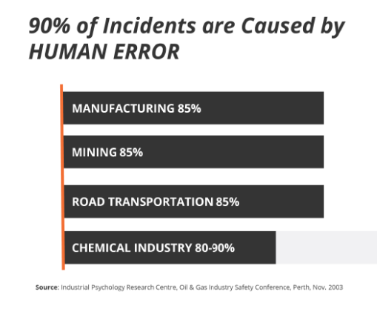
Causes of Workplace Incidents
CONSTRUCTION 90-95%

Slide 9
Timeline of Incident Causation
HIGH-RISK HUMAN FACTOR
UNSAFE BEHAVIOR
INCIDENT

Slide 10



Business Challenges
Cost of workplace violence:
$36 billion
http://www.businessinsider.com/surprising-costs-to-the-work-place-2011-11?op=1
Cost of workplace injuries:
$62 billion
2016 Liberty Mutual Workplace Safety Index
Cost of theft and fraud:
$600 billion
http://www.businessinsider.com/surprising-costs-to-the-work-place-2011-11?op=1

Slide 11
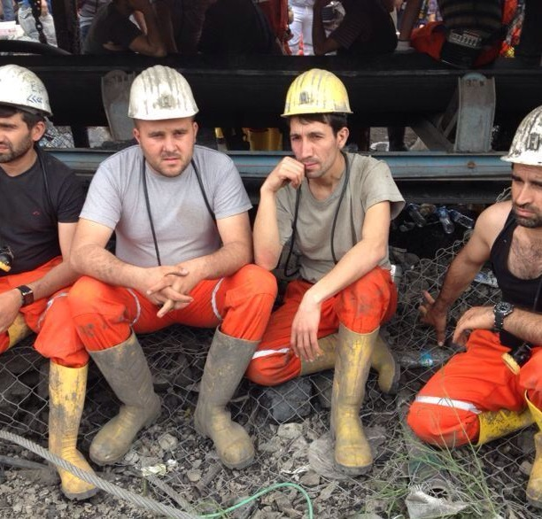
‘High-Risk’ Workers
1 out of 4 workers has a greater risk of incidents
What if you could SPOT them?
What if you could COACH them to behave safer?

Slide 12

The Problem
Background checks and reference checks are necessary!
But these tools focus on the PAST.
www.talentclick.com

Slide 13

The Problem
Traditional unstructured interviewing has a 50% success rate in hiring people who become ‘good’ or ‘high’ performers.

Slide 14

The Solution
Move assessments further AHEAD (earlier) in your hiring process.
We make it affordable enough that employers can test all qualified applicants, before ‘confirmation bias’ can set in.

Slide 15

The Impact
Businesses that use pre-employment assessments are 36% more likely than all others to be satisfied with new hires
Source: Pre-Hire Assessments: An Asset for HR in the Age of the Candidate, Zach Lahey, Aberdeen Research, 2015
Using assessments to hire top performers who ‘fit’ yields up to 67% higher productivity and profit
Source: McKinsey Quarterly, Nov 2009

Slide 16
Proven Validity & Reliability
MEASURE | Professional Standards (0.00 to 1.00) | TalentClick Assessments
RELIABILITY (test-retest and internal consistency reliability) | 0.70 | 0.75 to .86
VALIDITY (construct and content validity) (score = 0.00 or 1.00) | 1.00 | 1.00
VALIDITY (criterion-related) (correlation coefficients) | 0.11 | 0.15 to 0.32 * varies across dimensions
ETHICS, FAIRNESS & CONFIDENTIALITY (score = 0.00 or 1.00) | 1.00 | 1.00
PRACTICALITY & EFFICIENCY (score = 0.00 or 1.00) | 1.00 | 1.00
EEOC UNIFORM GUIDELINES AVOIDANCE OF ADVERSE IMPACT (score = 0.00 or 1.00) | 1.00 | 1.00

Slide 17

Superior Customer Satisfaction
“These reports exceeded my expectations. They were spot on... totally nailed it, very insightful.”
-Senior Manager, EPCOR Utilities
“I’d rate TalentClick a 10 out of 10. The product is great and the service has been exemplary.”
-Harriet Robinson, Vice President HR
“I have been waiting for a product like this my whole career.” -Christine Trombley, HR Manager, Zavcor Transportation
“We consider the tool an incredibly important part of our screening process.” –Dan Finley, VP HR, PWT
97%
Customer Satisfaction
score

Slide 18
What is Personality?

Slide 19
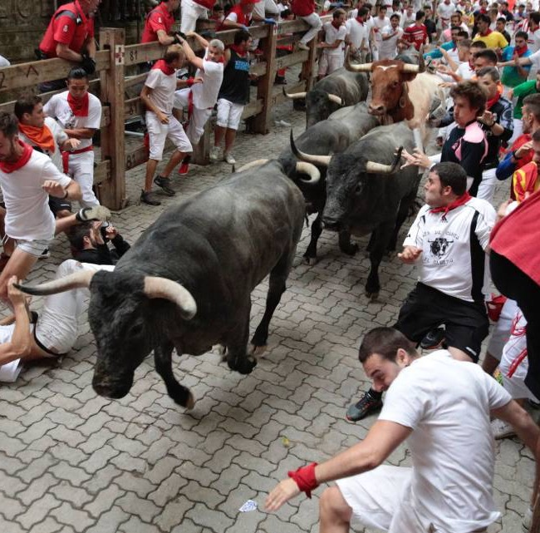
What is Your Reaction to This?
Some people are risk takers. Others avoid risk.

Slide 20

What is Your Reaction to This?
Some people are compliant with rules and authority.
Others are defiant and think rules apply to other people.

Slide 21












What is Personality?
‘Default settings’ or ‘hard-wiring’
Impulses or knee-jerk reactions
How we act when nobody is watching
Stable over time & resistant to change
Drives on-the-job behavior

Slide 22
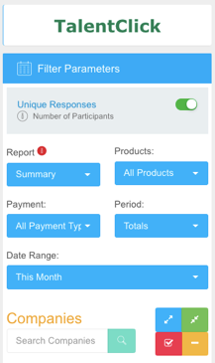
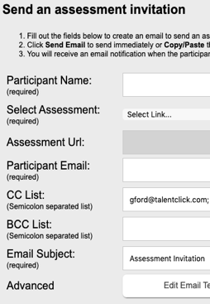

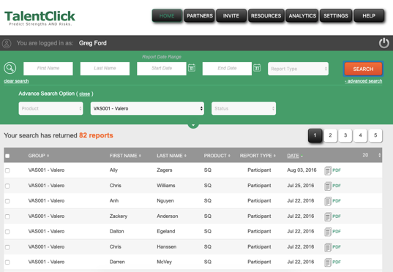
How Do We Measure Behavioral Risk?
Invites Applicants
•auto-send or manually email link
•post link on Job Portals, your ‘Careers’ page
Participants Complete Assessment
•10-15 minutes online
•20 languages
•basic reading level
•non-invasive
•no adverse impact
Get Results!
1. Reports automatically stored in your account on our cloud-based platform
2. Emailed as PDFs
3. Integrate with your ATS

Slide 23
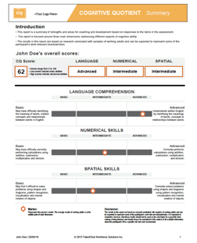
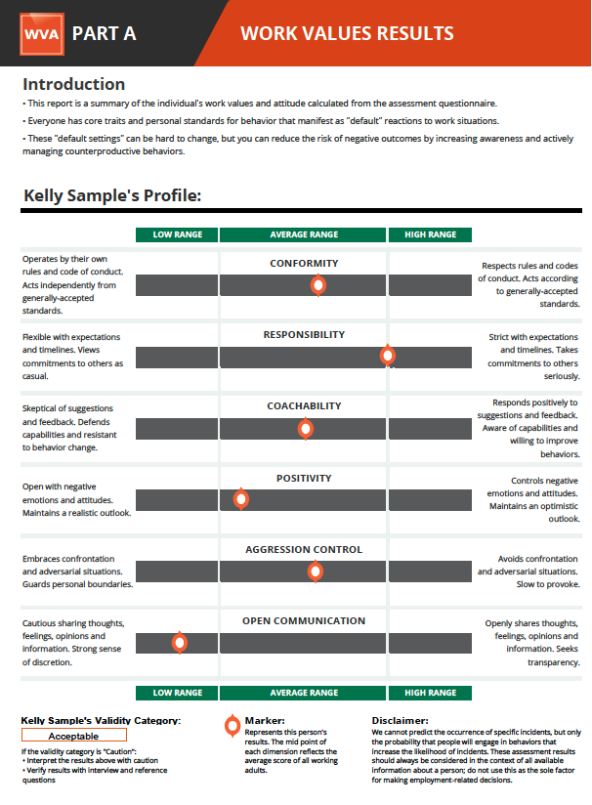
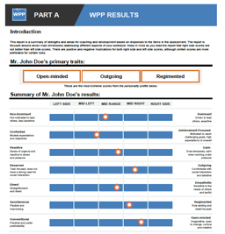
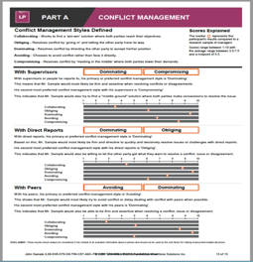
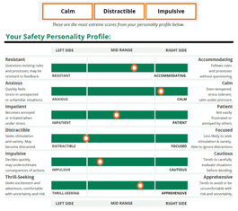
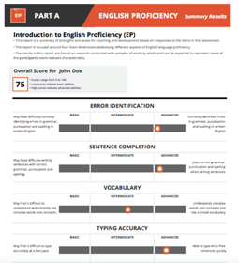
TalentClick Reports
Short reports. Highly visual. Easy-to-interpret results in plain language. No certification required!

Slide 24
Pre-Hire Applicant Screening & Selection

Slide 25

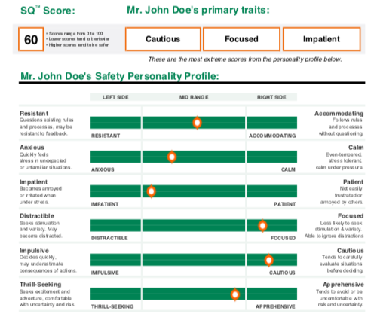

Safety Quotient (SQ) Report
Key Features:
Safety Snapshot
Coaching Tips
SafeSELF Action Plan
www.talentclick.com
Notes:
The first part of every report shows the employee’s Safety Snapshot, a summary of their Safety Personality by each of the six dimensions:
Resistant vs. Accommodating
Anxious vs. Calm
Impatient vs. Patient
Distractible vs. Focused
Impulsive vs. Cautious
Thrill-Seeking vs. Apprehensive
For details of each dimension, ask Dean @ TalentClick for a sample report.

Slide 26

RESISTANT
ACCOMMODATING
Questions the reason or purpose behind rules & change
Readily points out areas for improvement
Naturally compliant
Receptive to coaching & re-training
Adaptable to change
Strengths
May defy safety rules & SOPs
May be resistant to coaching & behaviour change
May be slower to adapt to change
May ‘blindly ‘ follow rules when they are not appropriate
May fail to notice or point out areas for improvement
Risks

Slide 27
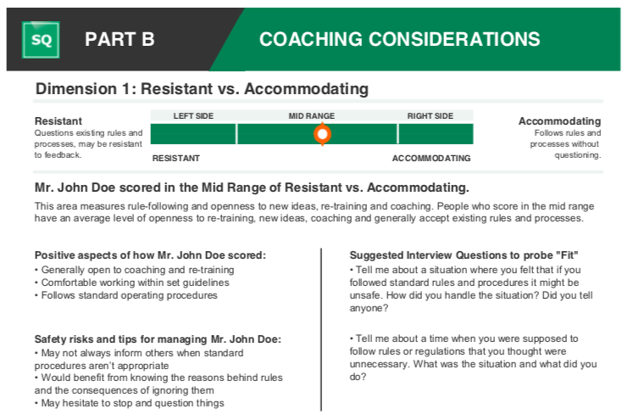
Personalized Interview Questions
Interview questions are personalized to each individual’s results.
This leads to more insightful interviews!

Slide 28
Post-Hire Employee Training & Coaching

Slide 29
1. Management Advice
Coaching tips are personalized to each individual’s results.

Slide 30
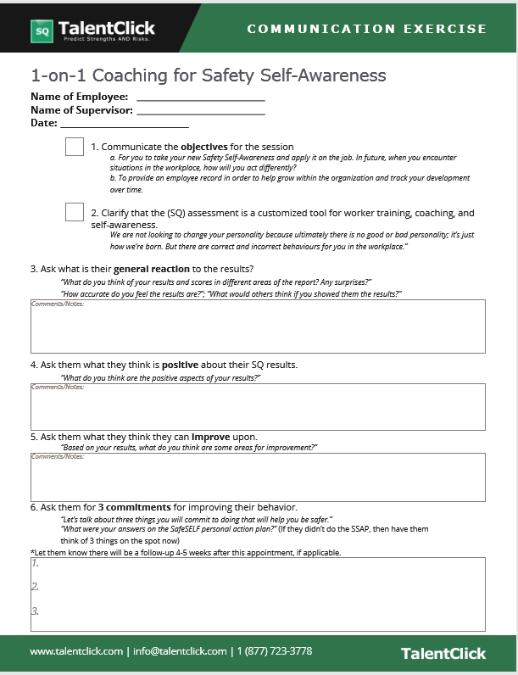
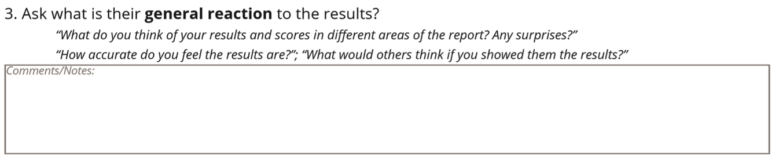
2. Coaching
Guide

Slide 31
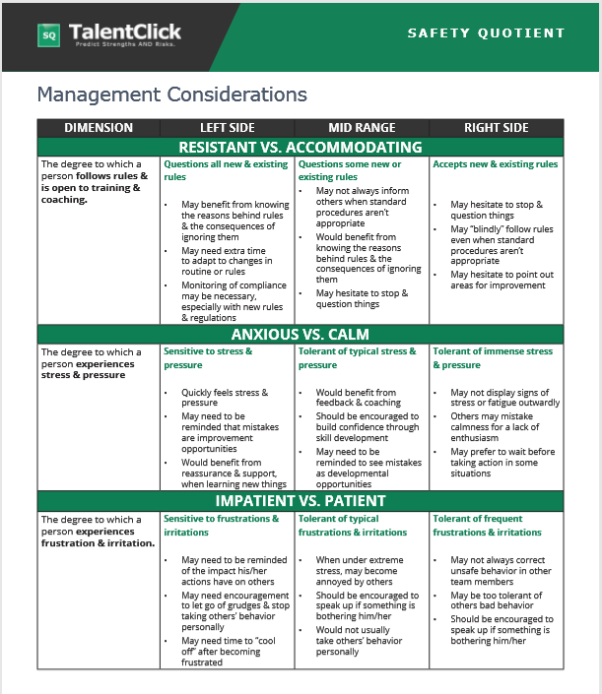
3. Quick-Reference
Sheet

Slide 32
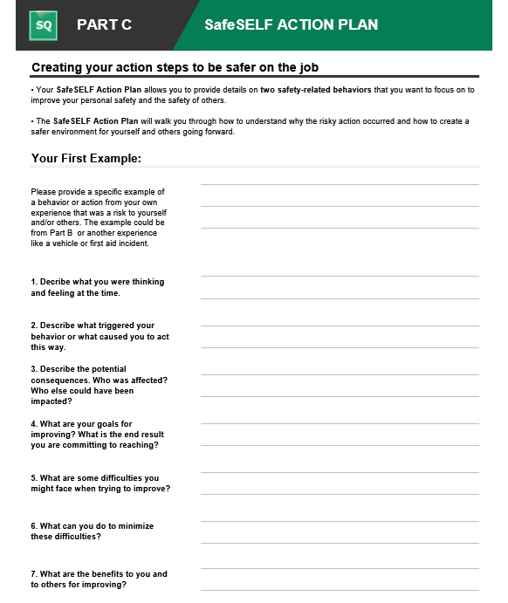
4. SafeSELF
Action Plan

Slide 33
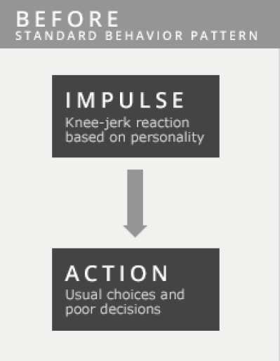
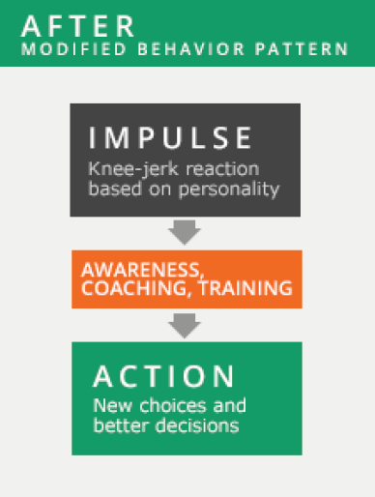
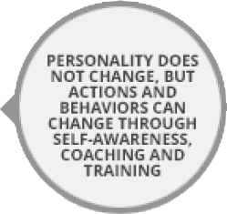
Key Message About Behavioral Change

Slide 34
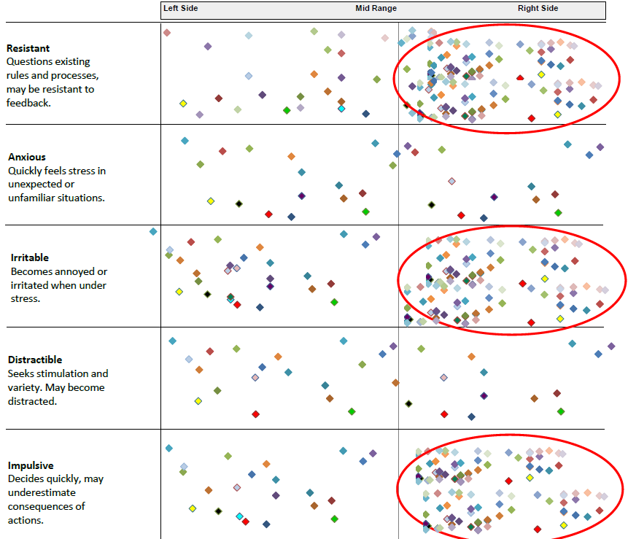
Group Report
More First Aid Incidents & Recordable injuries
More First Aid Incidents & Near Misses
More First Aid Incidents & Recordable injuries
Notes:
This is what the report looks like. We’ll talk later about the specific dimensions, but for now, you can see there are 5 areas that we measure: Rule Resistance
Anxiety or Nervousness
Irritability
Distractibility
Impulsiveness
Why do we measure these 5 dimensions?
Decades of research has shown that these are the 5 personality dimensions that have been most strongly linked to incident causation. (as we saw earlier, up to 90% of workplace incidents/injuries are the result of human error, so wouldn’t you say there’s value in highlighting individual’s risk areas?)
Other FAQs:
Can it be faked? Our assessments are very difficult for people to fake. First, the survey questions are non-transparent i.e., it is very difficult to know which answers will lead to more favorable scores. Second, the assessment has built-in measures for the gauging likelihood that a person is answering dishonestly. (This is called motivational distortion).
Will the results be used as a "pass" or "fail"? Any personality assessment should be used as just one of the sources of information to be used in hiring and employee development rather than being used as a pass/fail or sole factor for an employment-related decision.
How scientifically accurate and reliable is this? If you like stats and data, then we can provide a full Technical Manual for you. [Note to facilitator: Sometimes there is “that guy” in the room who will ask for something more, so here are the facts: Criterion-related Validity: r values in the .2 to .3 range and statistically significant at the p=<.01 level. When talking about Reliability of the SQ dimensions measured by internal consistency, Reliability: r values exceed .75 and statistically significant at the p=<.01 level. But don’t try to be an expert in this area. Just tell them that you’ll refer questions about research methodology to TalentClick].
Are there case studies? Yes, there is plenty of research showing the correlation between personality risk and actual incidents in the workplace. In the next few slides, we’ll present a few.

Slide 35

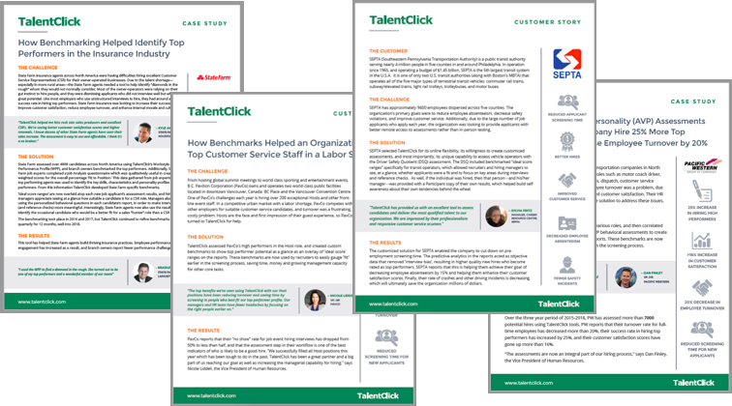
Customer Stories

Slide 36
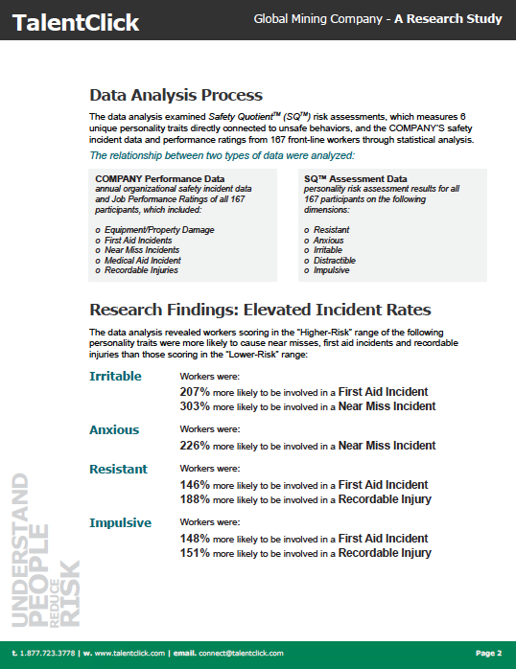
Research Study

Slide 37
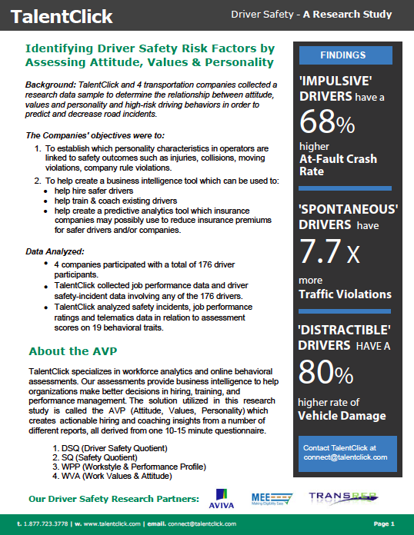
Research Study

Slide 38


Questions?
Greg Ford, M.Ed Workplace Learning, BA Psych
Managing Partner
Phone: 1.877.723.3778 Email: Info@TalentClick.com

